Slide 1
Trauma-Informed Practices for K12 Schools
Kognito. 2021. All Rights Reserved

Slide 2
Insert your name and contact information.

Slide 3
Workshop Schedule
Overview
Background of Trauma-Informed Practices for K12 Schools
SIMULATION
10-minute break
Group discussion
Role plays
Referral process
Takeaways

Slide 4
Group Norms
Actively participate.
Be respectful.
When sharing stories, do NOT share names or other identifying information of students or staff..
If you find any material triggering, take a break and rejoin later. Reach out to let me know.
Talk to me after the workshop if you are concerned about a student and have questions.

Slide 5
WRITE AN “AEIOU” DESCRIPTION.
A = Adjective - What word describes this image?
E = Emotion - How do you feel about the image?
I = Interesting - What is interesting to you about the image?
O = OMG - What surprised you about the image?
U = Um? - What question do you have about the image?

Slide 6
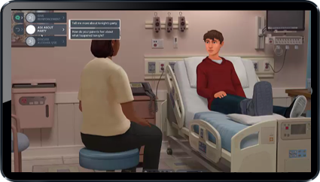
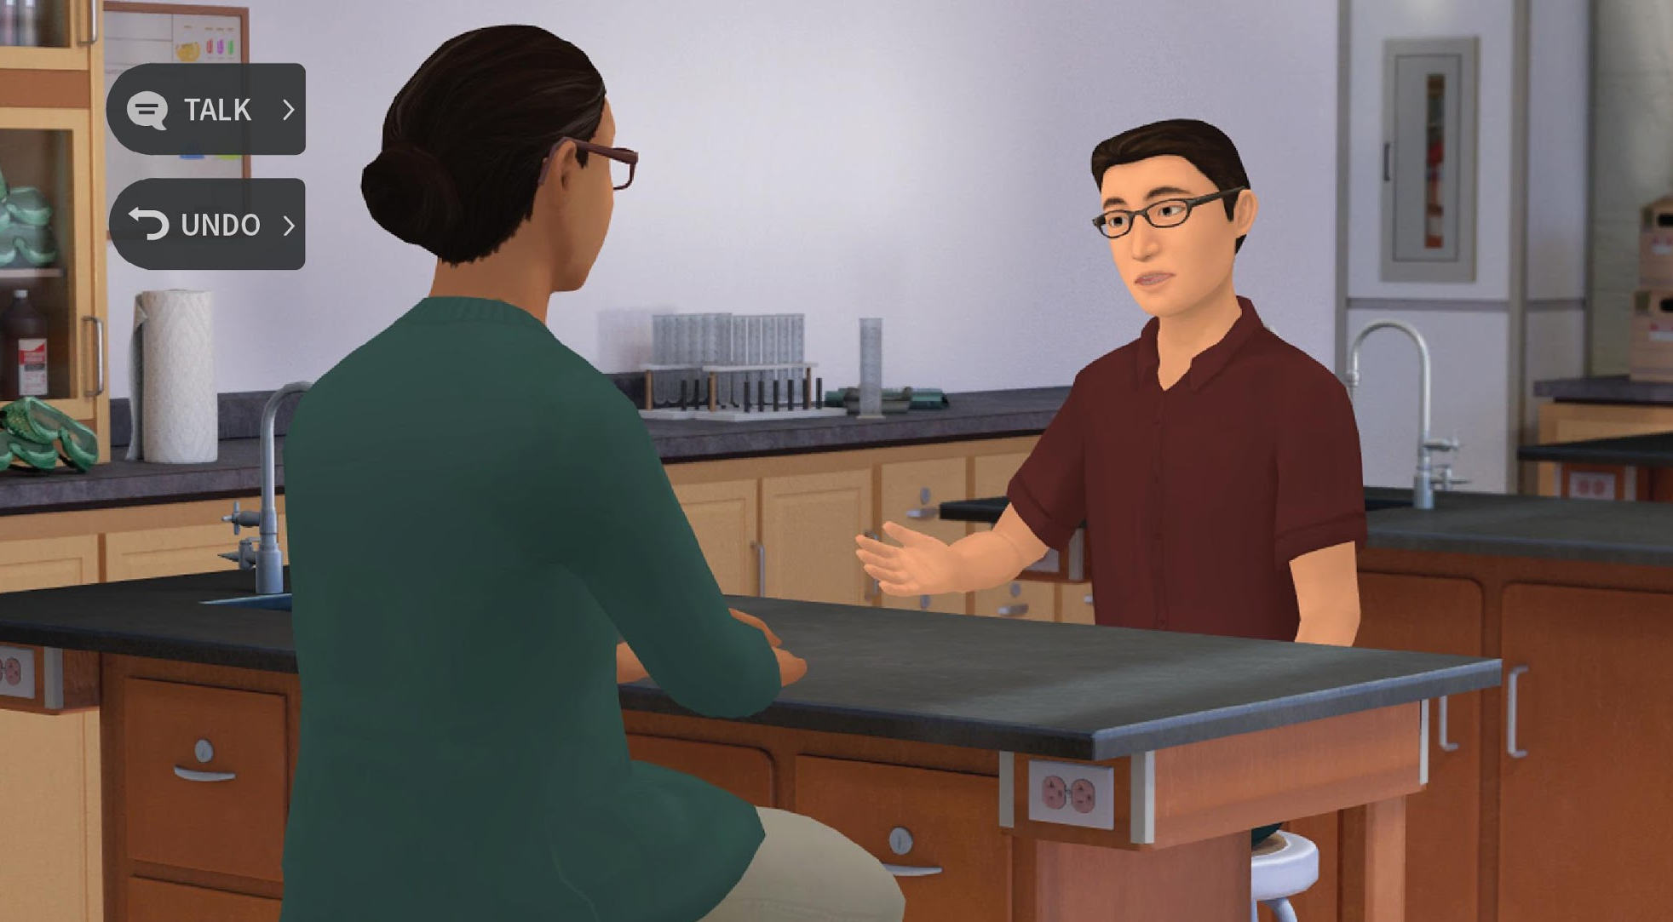
What is Kognito?
Kognito is a health simulation company that comprises learning experts, designers, technologists and implementation professionals.
Our evidence-based simulations build a variety of competencies and shape attitudes through role-play conversations with virtual people.
Over 1+ million educators, students, and health care professionals have used Kognito simulations to change lives, including over 500,000 K-12 educators.
Our innovative approach has resulted in partnerships with government agencies and NGOs.
Confidential Information. Kognito. All Rights Reserved. 2019
6

Slide 7
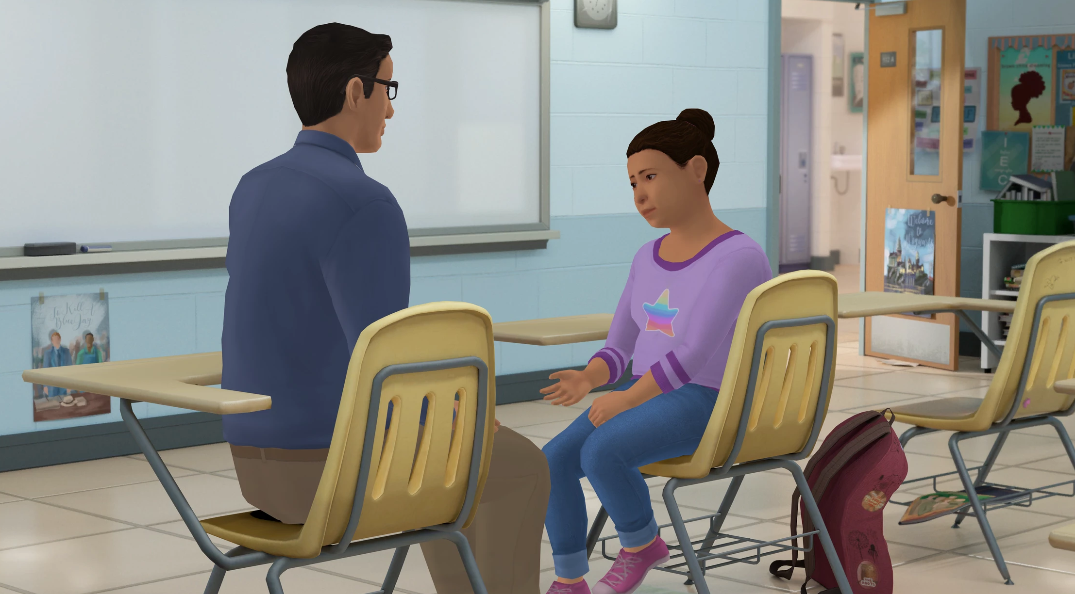
How Does A Kognito Simulation Work?
User interacts with a fully animated virtual student
Navigate through the scenarios by selecting what to say to the virtual student
Dialogue Options
Undo last selection
Receive instant feedback from the virtual coach and engagement meter
Can undo decisions and explore different conversation approaches
Receive personalized performance summary upon completion
Coaching Feedback
Engagement Meter

Slide 8
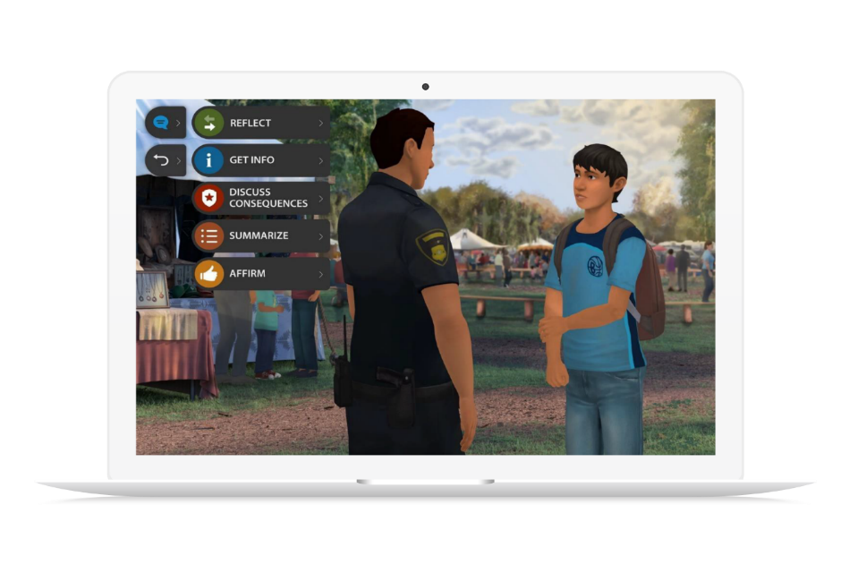
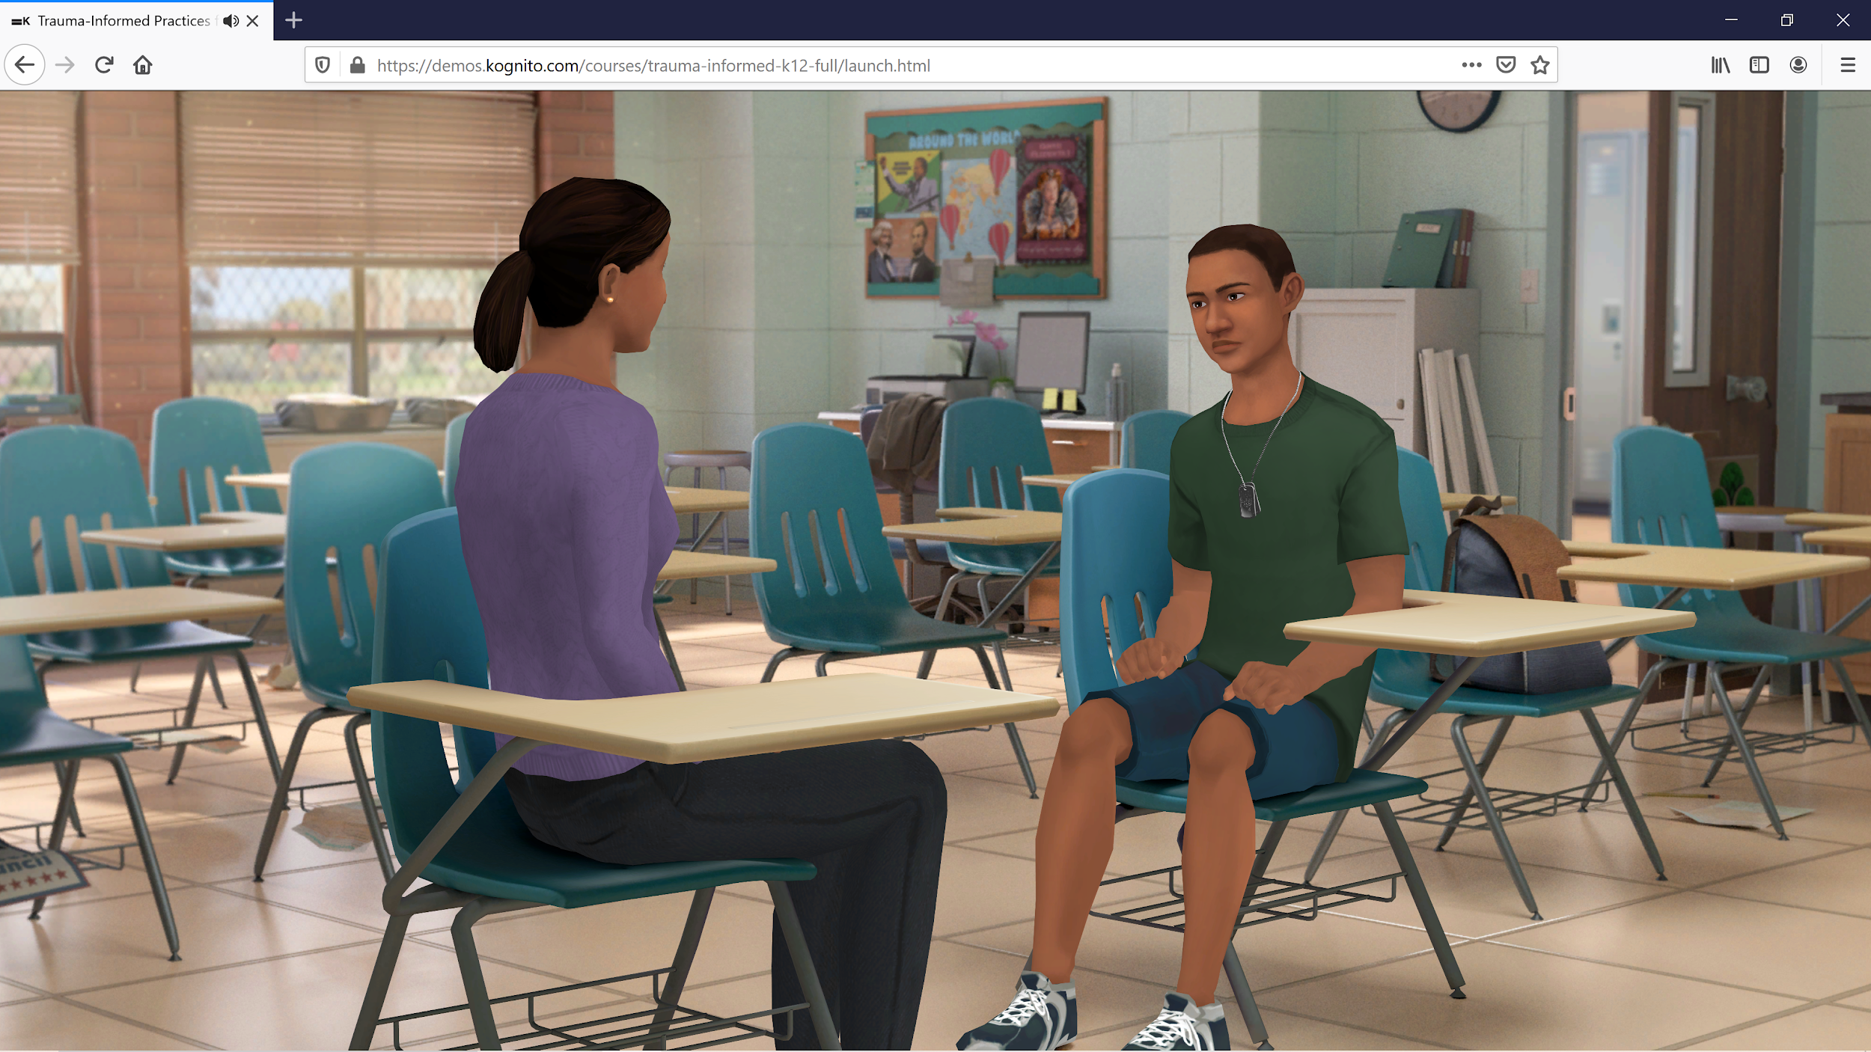
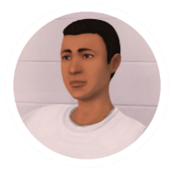
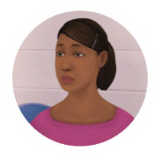
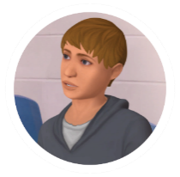
Trauma-Informed Practices for K12 Schools
TOPICS
USERS
Trauma and mental health
Educators, teachers, and staff
SETTINGS
DURATION
K12 schools
21-45 minutes
`
Lucas: A third grader who seems tired and distracted and is often absent
Charley: A 13 year old who is becoming increasingly despondent
Noah: A 17 year old with dropping grades and erratic behavior

Slide 9
Learning Objectives
Recognize when a student’s behavior might be the result of trauma or distress.
Lead conversations with a student about how they might be feeling.
Problem-solve ways that your class can become a more comfortable place for students who have experienced trauma.
Assess the need for referral, motivating students to seek help when needed.

Slide 10
Take the Simulation
www.KognitoCampus.com
For technical support or any questions about your simulation, please contact Kognito at support@kognito.com or 646-923-8632

Slide 11
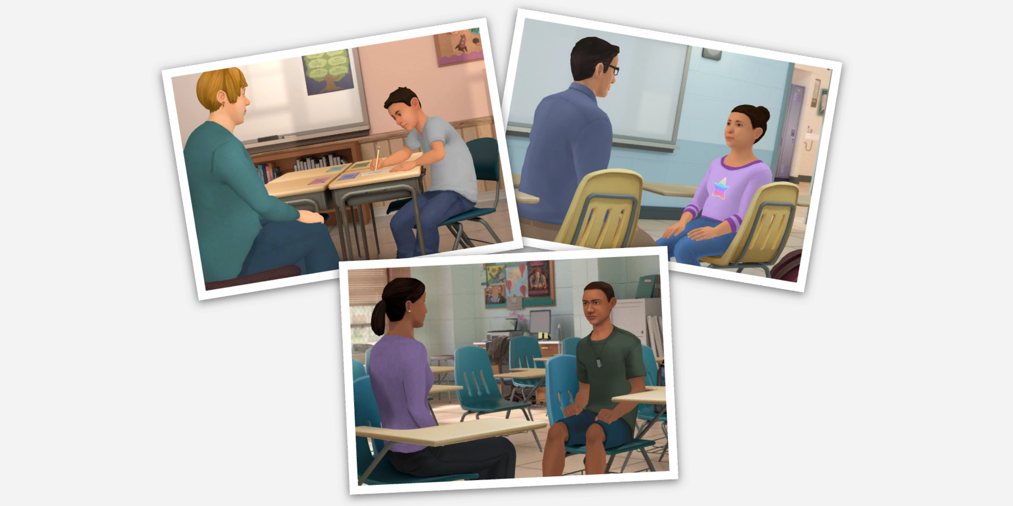

Slide 13
What We Might See
Aggression
Angry outbursts
Disengagement
Headaches and stomachaches
Inattention
Extreme fatigue
Social withdrawal
Easily distracted

Slide 14
Adverse Childhood Experiences (ACES)
Lived with a parent/guardian who: Got divorced or separated Died Served time in jail/prison Was mentally ill, suicidal, or severely depressed Behaved violently Had a problem with drugs/alcohol | Experienced: Violence (or witnessed it) Food scarcity Displacement

Slide 15
Approaching Students
Be specific about what you’ve observed.
Ask open-ended questions that encourage the student to open up.
Show empathy for what you think the student may be experiencing.

Slide 16
Referral Policy
What is the referral policy in our school? To whom do you make a referral if you are worried about a student in psychological distress that is not deemed an imminent threat to a student’s life?
Is that the school psychologist, guidance counselor, social worker, or nurse?

Slide 17
Insert Local Resources

Slide 18
3, 2, 1 Activity
Q. What are 3 things you learned?
Q. What are 2 questions you have?
Q. What is 1 way you’re going to change your practice?

Slide 19
Bridging the Gap
Q. Where You Are: List some of your observations.
Q. Where You’d Like To Be: List some of the qualities of your ideal school.
Q. What It Takes: List some ideas that might bridge the gap between where you are and where you’d like to be. What could happen to bring your school one step closer to your ideal?

Slide 20
Thank you!
The conversations you have
with students can open the door
to them getting the help they need.
If you do this for just one student, you will have made a difference.

