Slide 1

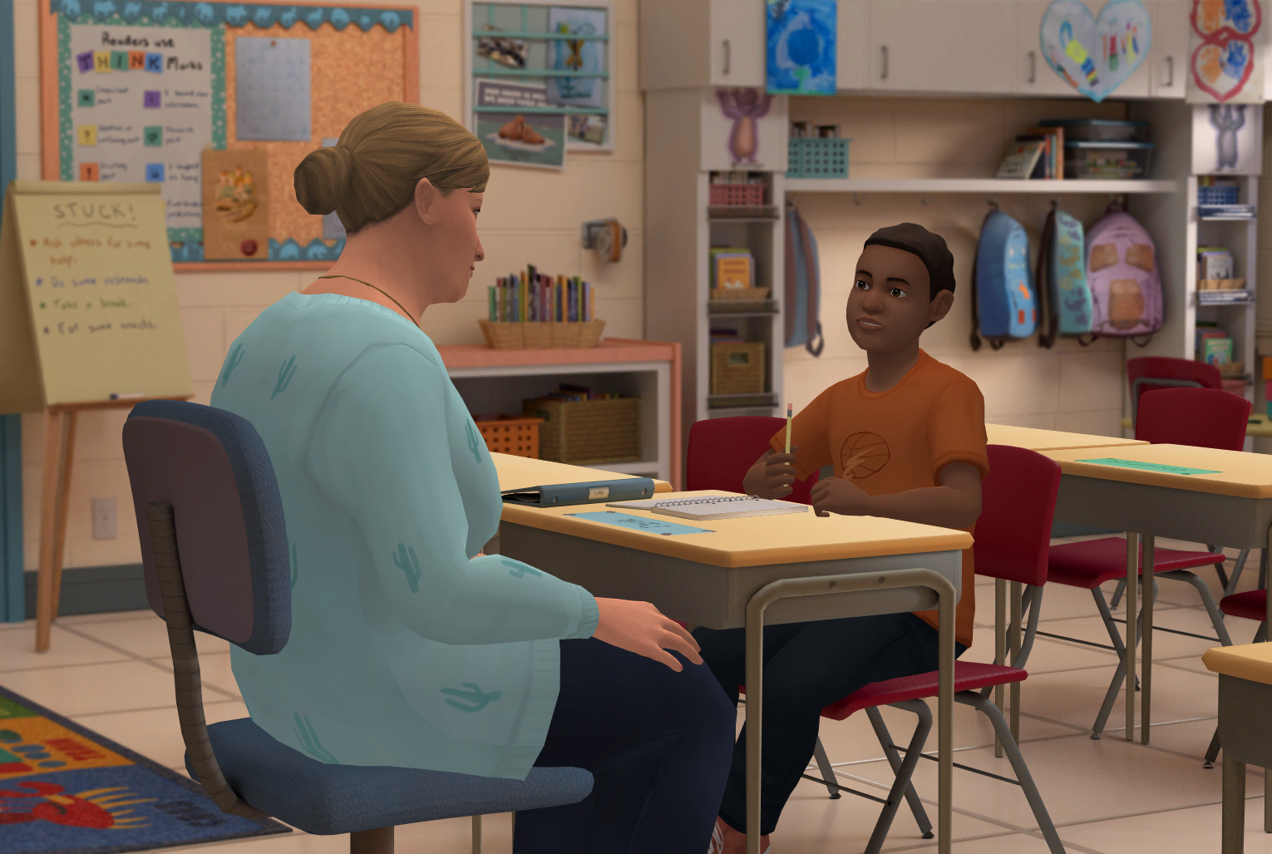





Insert Organization/
School Logo
At-Risk for Elementary School Educators
At-Risk for Elementary School Educators is an interactive role-play simulation for elementary school educators that builds awareness, knowledge, and skills about mental health, and prepares users to lead real-life conversations with students, parents, and caregivers about their concerns and available support.
Important Editing Instructions:
Insert your organization’s specific Kognito URL, i.e. districtname.kognito.com
Customize the method for which your organization is asking staff to log in. Either using their school email (rostered or SSO) or self registering
Insert the name(s) of the simulation(s) you are requiring
Insert high resolution PNG or JPG of your organization’s logo in the top left corner
Learning Objectives
Increase knowledge and awareness about children's mental health
Identify warning signs of psychological distress
Lead conversations with a student and a parent to lay the groundwork for referral and collaboration
Discuss concerns about students with parents
Encourage students to open up and motivate their parents to access support
Understand your school's specific support services and availability
Learners interact with Virtual Humans through interactive conversations
Access Instructions
Visit insertyourorganization.kognito.com
Select your school/institution
Create a new account using your organization email address as your username OR login using your organization email and the designated password
Launch Insert simulation name
Market
PK-12
Audience
Educator
Topic
Mental Health & Well-being and Suicide Prevention
Duration
60 Minutes

