Slide 1
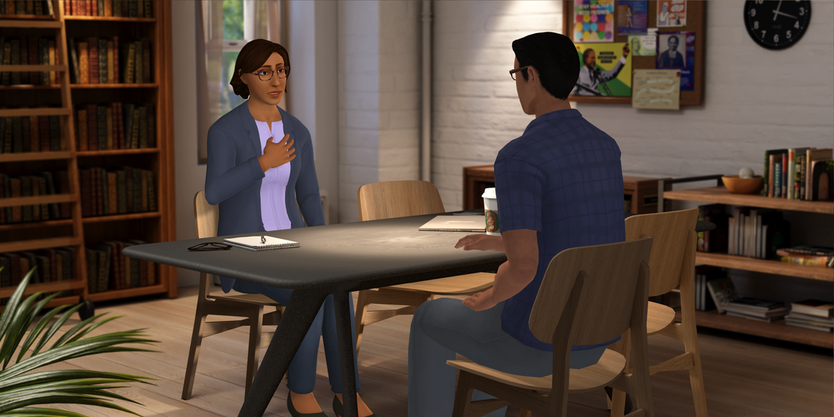
Welcome

Slide 2
Shared Expectations & Ground Rules
It’s important that each participant is given the time to express the full range of thoughts and/or ideas before someone responds.
Share from your own experiences.
It’s important that the group agrees to confidentiality. What is said in the group remains in the group.
Notes:
Graphic representation

Slide 3
Initial Reflections
Q1:
What surprised you about the information shared?
Q2:
Can you share any real-life examples of students that you have seen in distress (no names)?
If so, what signs referenced in the modules stood out for you?
Notes:
Graphic representation

Slide 4
Initial Reflections
Q3:
If you had one question about helping students in distress you want to make sure we cover, what would it be?
Notes:
Graphic representation

Slide 5
Q1:
What resource on campus can your students turn to when stressed?
Q2.
How about you, what sources would you turn to?
Stressors
Notes:
Graphic representation

Slide 6
Helping Students Open up – Creating Space
Option A • How are things going for you? • How do you feel about
what happened in class? • How do you unwind? • What have you been doing for fun? • What are you finding challenging?
Option B • How are things going for you? • How do you feel about
what happened in class? • How do you unwind? • What have you been doing for fun? • What are you finding challenging?
Notes:
Graphic representation

Slide 7
Final Reflection
Write a key takeaway and an action item for yourself and discuss it with your partner
Notes:
Graphic representation

Slide 8
Identity & Outreach Scenarios
Faculty - During an in-class group assignment, one of your students raises their voice towards another student in their group. Their tone and level of frustration is abnormal for them, and this is concerning to you. You acknowledge the disagreement and redirect the class. As the class ends, the student who had the outburst is seated and resting their head on their desk.
Staff - During a meeting, a student responds with frustration and aggression to a suggestion made by another student. Their tone and level of frustration is abnormal for them, and this is concerning to you. You acknowledge the disagreement and redirect the meeting. After the meeting ends, the student who had the outburst is just sitting at their table on their phone.
Notes:
Graphic representation

Slide 9
Identity & Outreach continued
Faculty
I noticed that you fell asleep in class yesterday.
(Specific Neutral Observation)
Falling asleep in class is disrespectful. (Judgmental)
Staff
I noticed that you’ve missed our last few volunteer opportunities. (Specific Neutral Observation)
Don’t you care about the community anymore? (Judgmental)
Notes:
Graphic representation

Slide 10
Reflections
Response with reflection:
Person 2 – That is a lot of incoming demands the first thing in the morning, I can only image that was stressful...especially without that first cup of coffee.
Person 1 - Today has been crazy, I had 15 new emails from students before I even had a chance to get a cup of coffee.
Notes:
Graphic representation

Slide 11
Suicidal Ideation and Referral
If you are ever concerned that a student may be having thoughts of suicide or self-harm it is always okay to ask.
It is okay to ask directly but be sure to maintain a non-judgmental tone. Asking a student if they are thinking about suicide is direct and does not imply any judgment.
Asking will not put the idea in their head. In fact, they might be relieved that someone asked them, and they can talk about it.
Notes:
Graphic representation

Slide 12
Expressing a desire to kill themselves or be dead
Expressing feelings of hopelessness, helplessness, or futility
Expressing feelings of alienation or isolation
Verbal or written statements like, “Life isn’t worth living anymore,” or “People would be better off without me.”
Looking for a way to end their life
Suicidal Ideation and Referral
Warning Signs
Notes:
Graphic representation

Slide 13
Suicidal Ideation and Referral
Referral
We invite you to work with your mental health team to edit this section, to include the process and resources for your campus.
Review the campus process and then have participants practice asking the question and making a warm handoff.
Notes:
Graphic representation

Slide 14
Recap
Specific Neutral Observations
Reflections
Suicidal Ideation
Connecting with Support
Notes:
Graphic representation

Slide 15
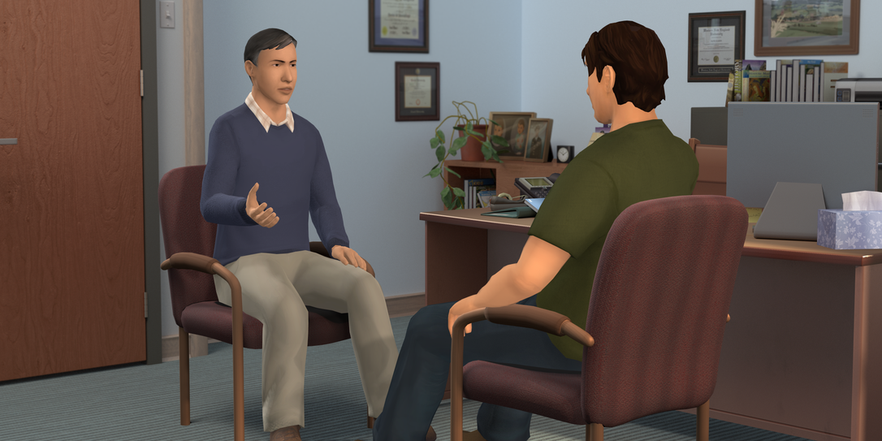
Notes:
Graphic representation

