Slide 1
Workshop Discussion Guide Companion Slides
Emotional & Mental Wellness for Elementary & Middle School
Trauma-Informed Practices for Elementary & Middle School

Slide 2
Insert your name and contact information

Slide 3
Workshop Overview
___________________________________________________________________
Welcome!
Program background
Take first simulation
15-minute break
Take second simulation
Group Discussion
Role plays
Our school’s referral process
Takeaways

Slide 4
Group Norms
___________________________________________________________________
Actively participate.
Be respectful.
When sharing stories, do NOT share names or other identifying information of students or staff.
Seek help if you would like to discuss personal mental health.
If you find any material triggering, take a break and rejoin later. Reach out to let me know.
Talk to me after the workshop if you are concerned about a student and have questions.

Slide 5
WRITE AN “AEIOU” DESCRIPTION.
A = Adjective – What word describes this image?
E = Emotion – How do you feel about the image?
I = Interesting – What is interesting to you about the image?
O = OMG – What surprised you about the image?
U = Um? – What questions do you have about the image?

Slide 6
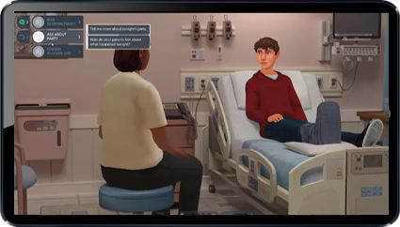
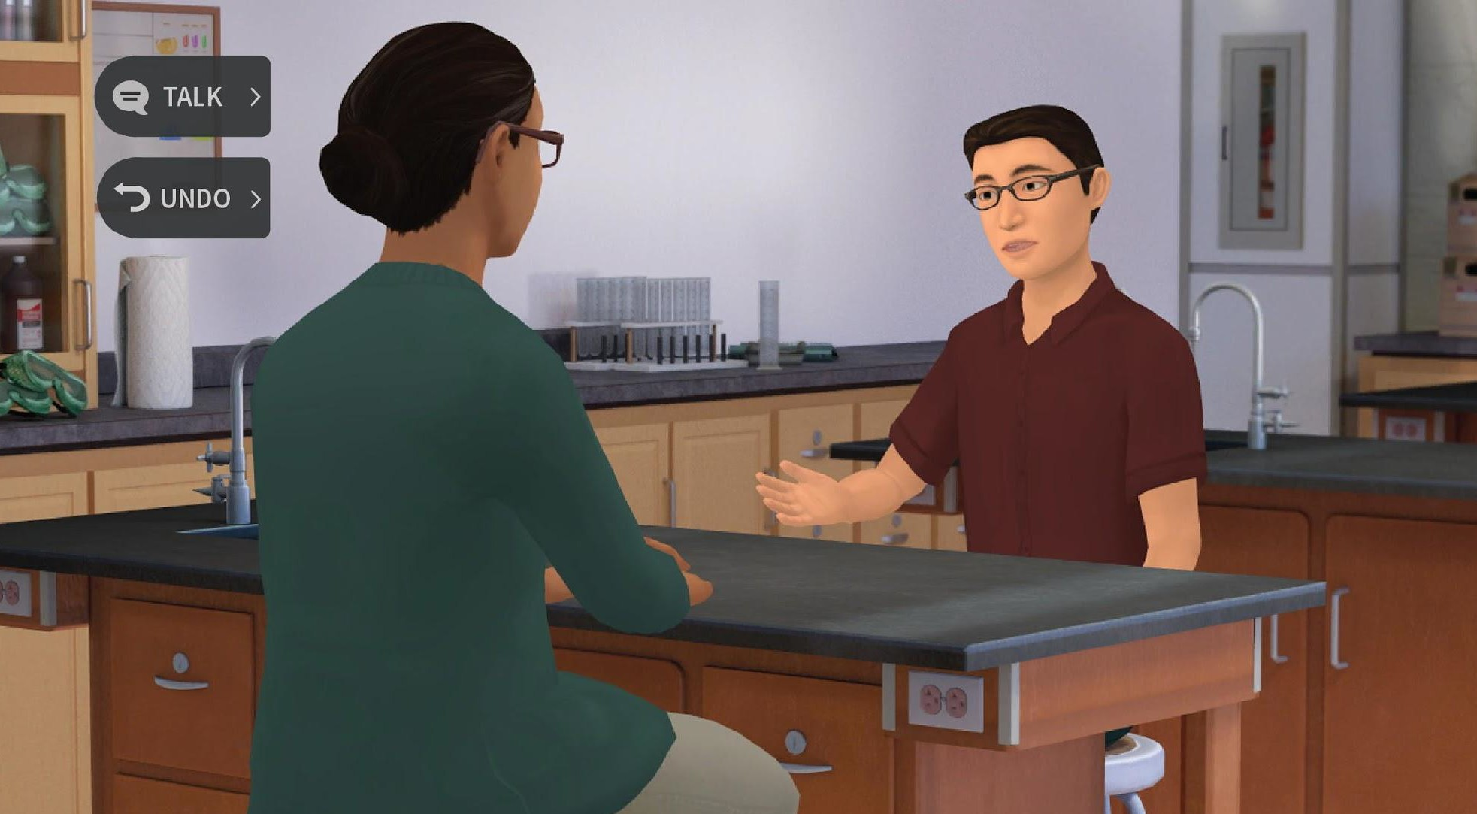
About Kognito
Kognito is a leading provider of practice-based digital learning experiences that provide strategies to improve mental health and well-being across schools and communities.
Our simulations are built on an interactive platform and integrates several evidence-based models and techniques, game mechanics, and learning principles, allowing users to learn by engaging in role-play conversations with emotionally responsive virtual humans.
Kognito has been instrumental in providing training to over 1.5 million educators, administrators, students, and their communities. This innovative approach is changing lives by increasing user confidence and awareness on critical topics that impact critical thinking and decision-making.

Slide 7
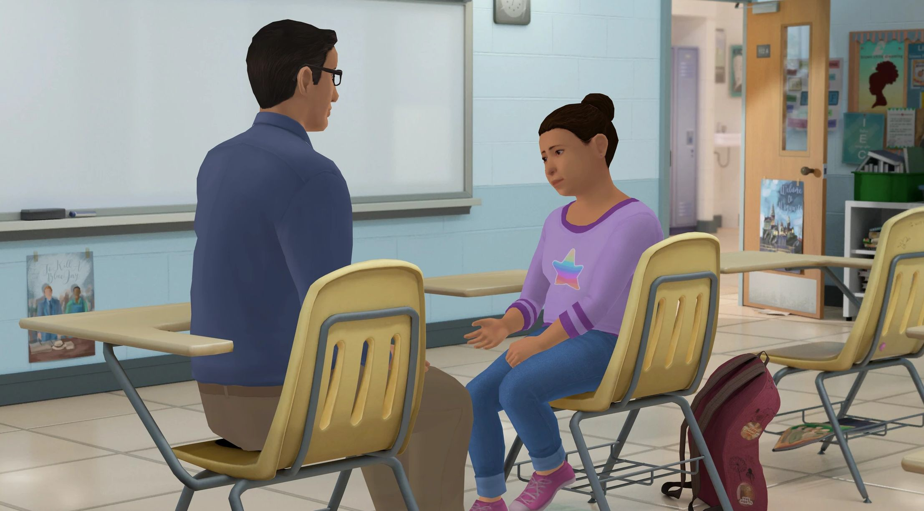
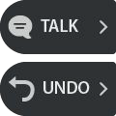
How does a Kognito Program Work?
User interacts with a fully animated at-risk virtual student
Navigate through the scenarios by selecting what to say to the virtual student
Receive instant feedback from the virtual coach and engagement meter
Can undo decisions and explore different conversation approaches
Receive personalized performance summary upon completion
Dialogue Options
Undo last selection
Coaching Feedback
Engagement Meter

Slide 8
Emotional & Mental Wellness: Elementary and Middle School
TOPICS | USERS | SETTINGS | DURATION
Mental Health, suicide prevention, resilience | Educators, teachers, and staff | Elementary and Middle schools, youth programs, foster care, juvenile justice | 30 minutes

Slide 9
Learning Objectives
Know how to regularly check in with students and build resilience.
Recognize warning signs and risk factors that a student may be in distress and need support.
Have a supportive conversation with a student who may be distressed.
Connect the student to appropriate support services.
Handle difficult situations where the student may be a threat to themselves or others.

Slide 10
Take the Simulation
<Insert custom url>
For technical support or any questions about your simulation, please contact Kognito at support@kognito.com

Slide 11
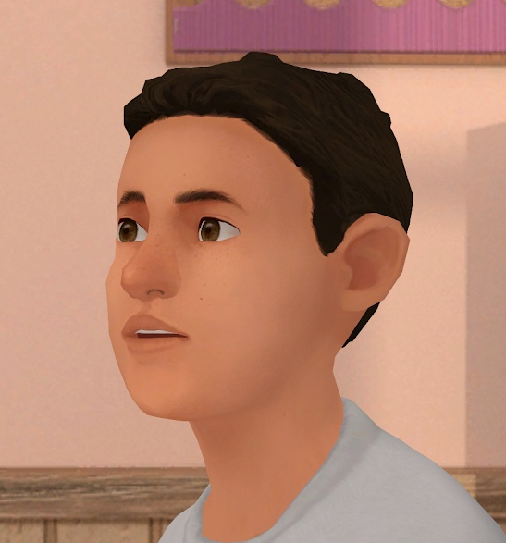
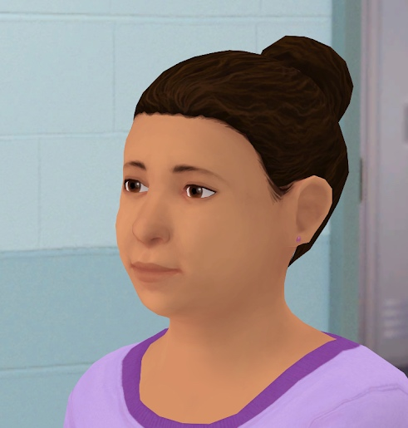
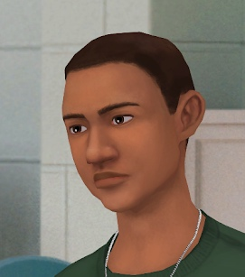
Trauma-Informed Practices for Elementary and Middle School
TOPICS | USERS | SETTINGS | DURATION
Trauma and Mental Health | Educators, teachers, and staff | Elementary and Middle schools | 21-45 minutes
`
Lucas: A third grader who seems tired and distracted and is often absent
Charley: A 13-year-old who is becoming increasingly despondent
Noah: A 17-year-old with dropping grades and erratic behavior

Slide 12
Learning Objectives
Recognize when a student’s behavior might be the result of trauma or distress.
Lead conversations with a student about how they might be feeling.
Problem-solve ways that your class can become a more comfortable place for students who have experienced trauma.
Assess the need for referral, motivating students to seek help when needed.

Slide 13
Take the Simulation
<Insert custom url>
For technical support or any questions about your simulation, please contact Kognito at support@kognito.com or
646-923-8632

Slide 14
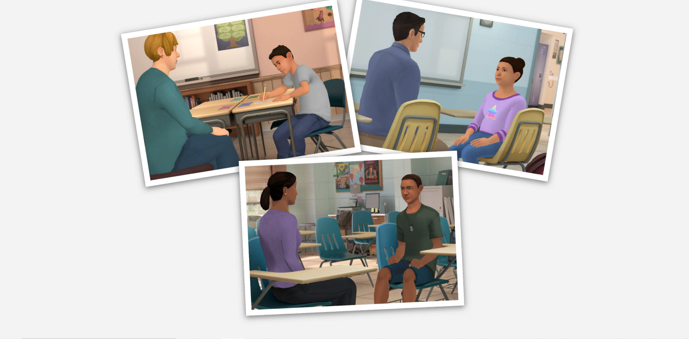

Slide 15
A positive classroom environment promotes connectedness and resilience, creating a pathway to discuss concerns.

Slide 16
How can I check-in with my students?
Ask them to share feelings with a partner, in a small group, or in a check-in circle.
Sample instructions:
“…compliment someone else.”
“…tell us about your weekend.”
“…explain how you’re feeling today and why.”

Slide 17
How can I check-in with my students?
Mood meters help students identify how they feel in the moment.
We have emotions all the time, whether or not we take time to notice them.
They affect the ways we work and interact with others.
Recognizing our emotions is the first step to regulating them.

Slide 18
How can I check-in with my students?
Journaling and/or drawing is a great way for students to express feelings.
Sample prompts: “Write or draw about…”
“…how you feel today.”
“…what you did over the holidays.”
“…someone you love.”
Play music or a video at the beginning of class. Ask students to journal their feelings about it.

Slide 19
De-escalating distressed students
____________________________________________________________________________
Mindfulness: Students sit quietly, eyes closed, while the teacher leads them in a breathing and focus exercise until they are calm and in control again.
Deep Breathing: Students close their eyes and count slowly to 10, taking deep breaths.
Journaling / Drawing: Give students a quiet place to draw, color, or journal what they feel before they return to learning.
Movement: Provide space where students can safely move their body, such as walking, doing arm circles, or even jumping.

Slide 20
Warning Signs
____________________________________________________________________________
Quieter during class
Not participating in activities
Inability to emotionally regulate
Irritability
Not completing assignments
Getting sick more often
Skipping class
Being absent
Running away
Frequent use of substances
Increased use of riskier drugs
Gambling

Slide 21
Risk Factors
____________________________________________________________________________
Intense feelings
Feelings of hopelessness, failure, or rejection
Relationship struggles
Family conflicts
Questions around sexual orientation and/or gender identity
Death of a friend or family member
Transitioning homes
Having a caregiver incarcerated
Letting go of future plans

Slide 22
Adverse Childhood Experiences (ACES)
____________________________________________________________________________
Lived with a parent/guardian who:
Got divorced or separated
Died
Served time in jail/prison
Was mentally ill, suicidal, or severely depressed
Behaved violently
Had a problem with drugs/alcohol
Experienced:
Violence (or witnessed it)
Food scarcity
Displacement

Slide 23
Approaching Students
____________________________________________________________________________
Be specific about what you’ve observed.
Ask open-ended questions that encourage the student to open up.
Show empathy for what you think the student may be experiencing.

Slide 24
Conversation Techniques
____________________________________________________________________________
Observable behaviors
Open-ended questions
Reflections

Slide 25
Observable Behaviors
____________________________________________________________________________
Reduce defensiveness by only mentioning what you observed (“just the facts”)
No judgement or exaggeration
Don’t try to interpret the student’s intentions or reasons for the behavior
Neutral tone of voice; neutral words
“I” statements: “I think…” “I noticed…” “I saw…”

Slide 26
Open-Ended Questions
____________________________________________________________________________
Can’t be answered in one word
Help students open up about what they’re feeling, thinking, and experiencing

Slide 27
Reflections
____________________________________________________________________________
Paraphrase what the student is saying, thinking, or feeling
Reflections help ensure you understand and show you are listening
They encourage the student to keep talking
“What I’m hearing is…” or “It sounds like…”

Slide 28
When should I refer?
____________________________________________________________________________
If worried, err on the side of referral.
Does the student feel helpless or alone?
Do they feel like a burden on others?
Are they seeking revenge?
Are they experiencing anxiety or pain?
Do they feel like there’s no reason to live?

Slide 29
How do I suggest counseling?
____________________________________________________________________________
Normalize it
“The counselor has helped students with similar issues…” (don’t name names!)
Discuss advantages
“It can feel good to talk about your feelings.”
“The counselor can help you meet your goals.”
Make the introduction
“I can introduce you.”

Slide 30
How do I ask about suicide?
✘ You’re not thinking about suicide, are you?
✘ You wouldn’t kill yourself. I know you’re smarter than that.
✔ Are you considering suicide?

Slide 31
What if a student might be suicidal?
Gather as much information as the student is willing to give
Are they thinking about suicide?
Do they have a plan?
Do they intend to act on the plan?
Do they have the means to act on the plan?
Connect the student immediately and in person to a supportive counselor, staff member, local service provider, or crisis center.
Suicide & Crisis Lifeline
3-digit dialing code: 988
24 hours a day, seven days a week

Slide 32
Role-Play Techniques
____________________________________________________________________________
Observable behaviors
Open-ended questions
Reflections

Slide 33
What is the referral policy in our school? To whom do you make a referral if you are worried about a student in psychological distress that is not deemed an imminent threat to a student’s life?
Is that the school psychologist, counselor, social worker, or nurse?
Referral
Policy

Slide 34
Insert local resources

Slide 35
3, 2, 1 Activity
Q. What are 3 things you learned?
Q. What are 2 questions you have?
Q. What is 1 way you’re going to change your practice?

Slide 36
Bridging the Gap
Q. Where You Are: List some of your observations.
Q. Where You’d Like To Be: List some of the qualities of your ideal school.
Q. What It Takes: List some ideas that might bridge the gap between where you are and where you’d like to be. What could happen to bring your school one step closer to your ideal?

Slide 37
Thank you!
The conversations you have with students can open the door to them getting the help they need.
If you do this for just one student, you will have made a difference.

