Slide 1
Workshop Companion Slides
Emotional & Mental
Wellness: Elementary and Middle School
Kognito 2021. All Rights Reserved

Slide 2
Insert your name and contact information.

Slide 3
Workshop
Overview
•
Simulation background
•
Welcome!
10-minute break
•
Role plays
Take simulation
15-minute break
Group discussion: identifying, approaching, referring students
Our school’s referral process
Takeaways
3

Slide 4
Group Norms
Actively participate.
Be respectful.
When sharing stories, do NOT share names or other identifying information of students or staﬀ.
Seek help if you would like to discuss personal mental-health.
If you nd any material triggering, take a break and rejoin later. Reach out to let me know.
•
Talk to me after the workshop if you are concerned about a student and have questions.
4

Slide 5
WRITE AN “AEIOU” DESCRIPTION.
A = Adjective - What word describes this image?
E = Emotion - How do you feel about the image?
I = Interesting - What is interesting to you about the image?
O = OMG - What surprised you about the image?
U = Um? - What question do you have about the image?

Slide 6
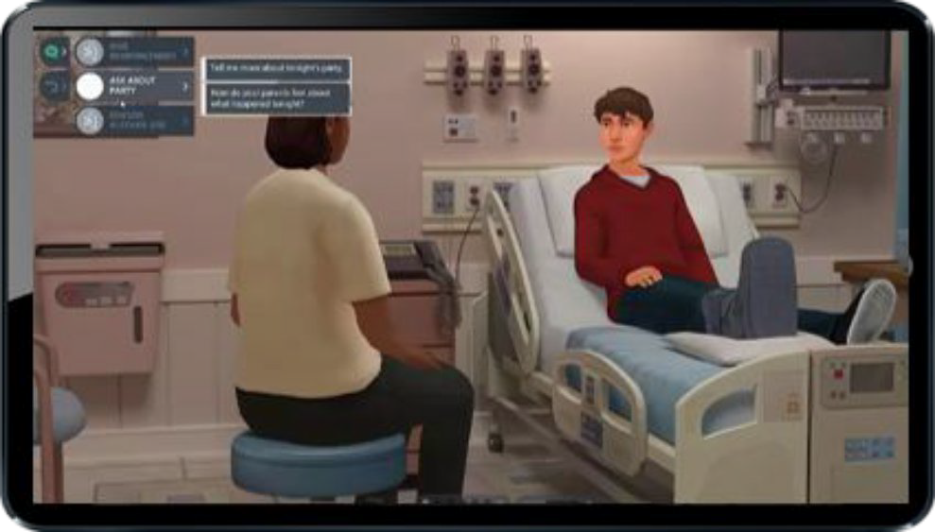
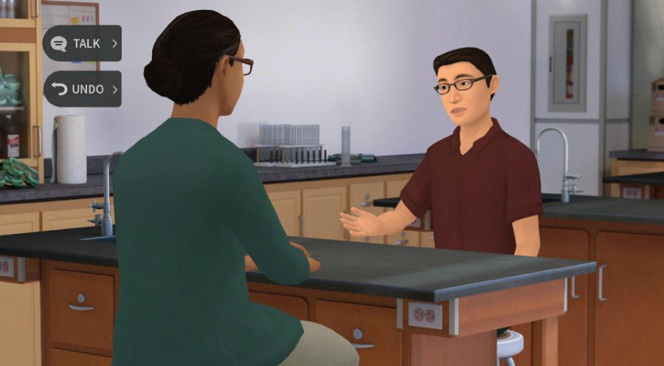
What is Kognito?
Kognito is a health simulation company that comprises learning experts, designers, technologists and implementation professionals.
Our evidence-based simulations build a variety of competencies and shape attitudes through role-play conversations with virtual people.
Over 1+ million educators, students, and health care professionals have used Kognito simulations to change lives, including over 500,000 K-12 educators.
Our innovative approach has resulted in partnerships with government agencies and NGOs.
6
6
Confidential Information. Kognito. All Rights Reserved. 2019

Slide 7
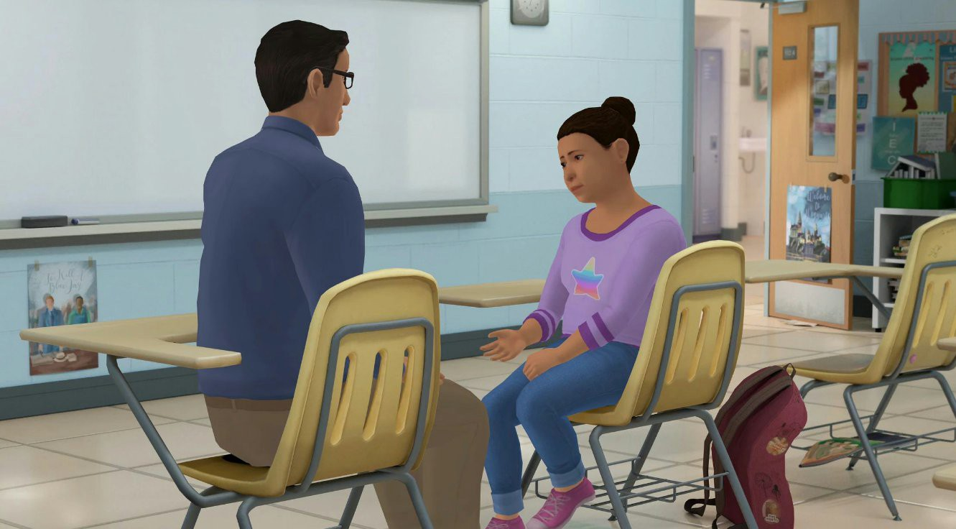
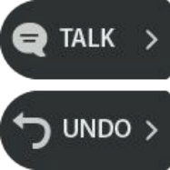
How Does a Kognito Simulation Work?
User interacts with a fully animated at-risk virtual student
Navigate through the
scenarios by selecting what to say to the virtual student
•
Dialogue Options
Undo last
selection
Receive instant feedback from the virtual coach and engagement meter
Can undo decisions and
explore different conversation approaches
Receive personalized performance summary upon completion
Coaching Feedback
Engagement Meter

Slide 8
Emotional & Mental Wellness: Elementary and Middle School
TOPICS
Mental health, suicide prevention, resilience
USERS
Educators, teachers, and staﬀ
SETTINGS
Elementary and Middle schools, youth programs, foster care, juvenile justice
DURATION
30 minutes

Slide 9
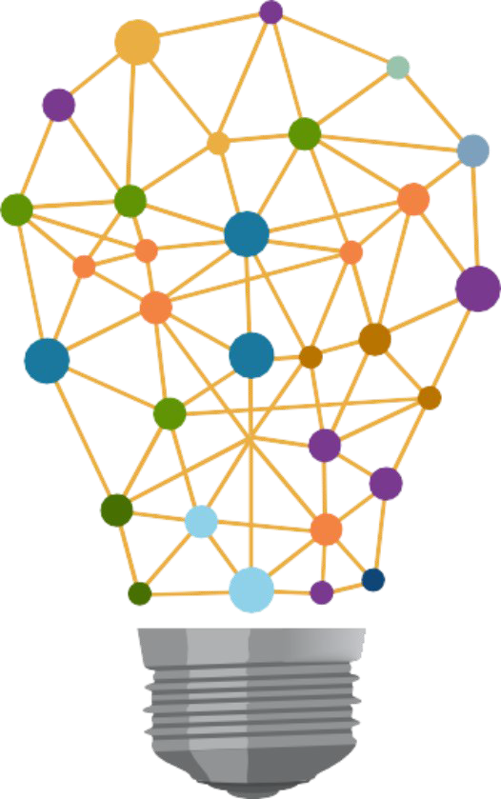
Learning Objectives
Know how to regularly check in with students and build resilience.
Recognize warning signs and risk factors that a student may be in distress and need support.
Have a supportive conversation with a student who may be distressed.
Connect the student to appropriate support services.
Handle difficult situations where the student may be a threat to themselves or others.
9

Slide 10
Take the Simulation Insert access instructions here. yourdistrict.kognito.com
For technical support or any questions about your simulation, please contact Kognito at support@kognito.com .

Slide 11
Emotional & Mental Wellness: Elementary and Middle School

Slide 12
A positive classroom environment promotes connectedness and resilience, creating a pathway to discuss concerns.

Slide 13
How can I check-in with my students?
Ask them to share feelings with a partner, in a small group, or in a check-in circle.
Sample instructions:
“...compliment someone else.”
“...tell us about your weekend.”
“...explain how you’re feeling today and why.”

Slide 14
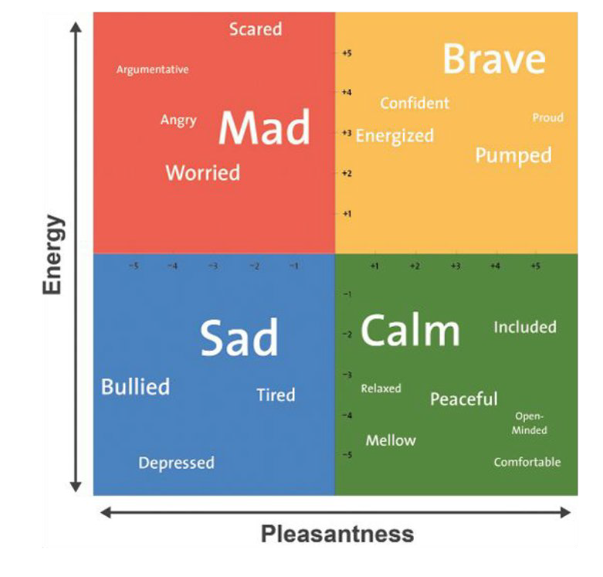
How can I check-in with my students?
Mood meters help students identify how they feel in the moment.
We have emotions all the time, whether or not we take time to notice them.
They aﬀect the ways we work and interact with others.
Recognizing our emotions is the rst step to regulating them.

Slide 15
How can I check-in with my students?
Journaling and/or drawing is a great way for students to express feelings.
Sample prompts: “Write or draw about…”
“...how you feel today.”
“...what you did over the holidays.”
“...someone you love.”
Play music or a video at the beginning of class. Ask students to journal their feelings about it.

Slide 16
De-escalating distressed students
Mindfulness: Students sit quietly, eyes • closed, while the teacher leads them in a breathing and focus exercise until
they are calm and in control again.
Journaling/Drawing: Give students a quiet place to draw, color, or journal what they feel before they return to learning.
Movement: Provide space where students can safely move their body, such as walking, doing arm circles, or even jumping.
Deep Breathing: Students close their eyes and count slowly to 10, taking deep breaths.

Slide 17
Warning Signs
Quieter during class
Not participating in activities
Inability to emotionally regulate
Irritability
Not completing assignments
Getting sick more often
Skipping class
Being absent
Running away
Frequent use of substances
Increased use of riskier drugs
Gambling

Slide 18
Risk Factors
Intense feelings
Feelings of hopelessness, failure, or rejection
Relationship struggles
Family conflicts
Questions around sexual orientation and/or gender identity
Death of a friend or family member
Transitioning homes
Having a caregiver incarcerated
Letting go of future plans

Slide 19
Conversation Techniques
Observable behaviors
Open-ended questions
Reections

Slide 20
Observable Behaviors
Reduce defensiveness by only mentioning what you observed (“just the facts”)
No judgment or exaggeration
Don’t try to interpret the student’s intentions or reasons for the behavior.
Neutral tone of voice; neutral words
“I” statements: “I think…” “I noticed…” “I saw…”
•
•

Slide 21
Open-Ended Questions
Can’t be answered in one word
Help students open up about what they’re feeling, thinking, and experiencing

Slide 22
Reflections
Paraphrase what the student is saying, thinking, or feeling
Reections help ensure you understand and show you are listening.
They encourage the student to keep talking.
“What I’m hearing is…” or “It sounds like…”

Slide 23
When should I refer?
If worried, err on the side of referral.
Does the student feel helpless or alone?
Do they feel like a burden on others?
Are they seeking revenge?
Are they experiencing anxiety or pain?
Do they feel like there’s no reason to live?

Slide 24
How do I suggest counseling?
Normalize it. -- “The counselor has helped students with similar issues…” (don’t name names!)
Discuss advantages. -- “It can feel good to talk about your feelings.” “The counselor can help you meet your goals.”
Make the introduction. -- “I can introduce you.”

Slide 25
How do I ask about suicide?
✘ You’re not thinking about suicide, are you?
✘ You wouldn’t kill yourself. I know you’re smarter than that.
✔ Are you considering suicide?

Slide 26
What if a student might be suicidal?
1) Gather as much information as the student is willing to share:
Are they thinking about suicide?
Do they have a plan?
Do they intend to act on the plan?
Do they have the means to act on the plan?
1) Connect the student immediately and in person to a supportive counselor, staﬀ member, local service provider, or crisis center.
The National Suicide Prevention Lifeline Call or Text: 988
24 hours a day, seven days a week
26

Slide 27
Role-Play Techniques
Observable behaviors
Open-ended questions
Reflections
27

Slide 28
•
What is the referral policy in our school? To whom do you make a referral if you are worried about a student in psychological distress that is not deemed an imminent threat to a student’s life?
Referral Policy
•
Is that the school psychologist, counselor, social worker, or nurse?
28

Slide 29
Insert Local Resources

Slide 30
3, 2, 1 Activity
Q. What are 3 things you learned?
Q. What are 2 questions you have?
Q. What is 1 way you’re going to change your practice?

Slide 31
Bridging the Gap
Q. Where You Are: List some of your observations.
Q. Where You’d Like To Be: List some of the qualities of your ideal school.
Q. What It Takes: List some ideas that might bridge the gap between where you are and where you’d like to be. What could happen to bring your school one step closer to your ideal?

Slide 32
Thank you!
The conversations you have with students can open the door
to them getting the help they need.
If you do this for just one student, you will have made a diﬀerence.

