Slide 1

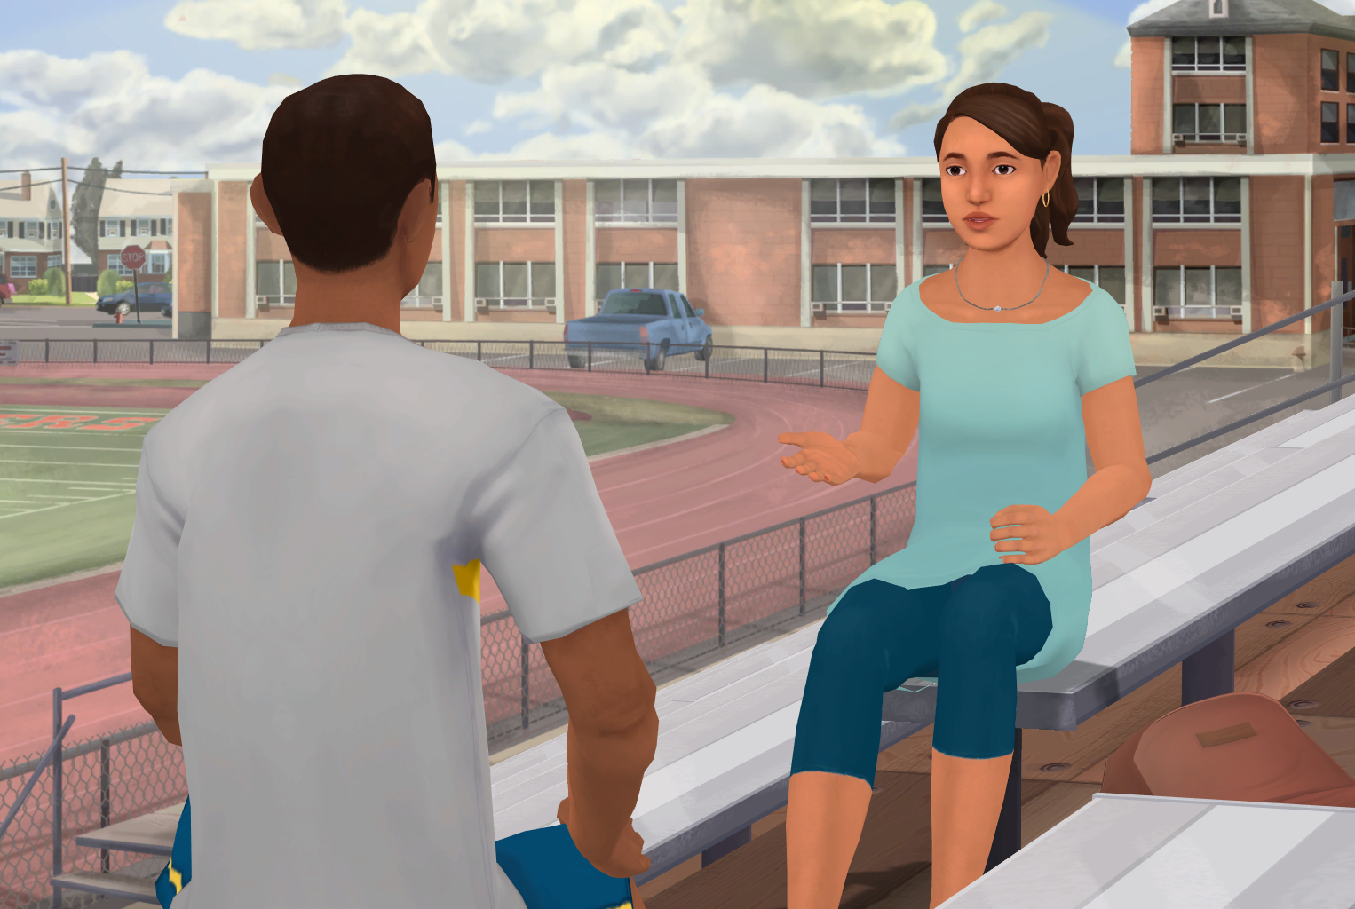





Insert Organization/
School Logo
Friend2Friend: Emotional & Mental Wellness
Friend2Friend: Emotional & Mental Wellness is an interactive role-play simulation for adolescents that builds awareness, knowledge, and skills about mental health while reducing the stigma.
Important Editing Instructions:
Insert your organization’s specific Kognito URL, i.e. districtname.kognito.com
Customize the method for which your organization is asking staff to log in. Either using their school email (rostered or SSO) or self registering
Insert the name(s) of the simulation(s) you are requiring
Insert high resolution PNG or JPG of your organization’s logo in the top left corner
Learning Objectives
Learn about mental health and wellness while reducing the stigma
Identify warning signs of psychological distress, including verbal, behavioral, and situational clues
Build skills to approach a peer in a manner to motivate them to access support
Become comfortable asking a friend if they are thinking about suicide
Access Instructions
Visit insertyourorganization.kognito.com
Select your school/institution
Create a new account using your organization email address as your username OR login using your organization email and the designated password
Launch Insert simulation name
Learners interact with Virtual Humans through interactive conversations
Market
PK-12
Audience
Student
Topic
Mental Health & Well-being, Social Emotional Learning, Suicide Prevention
Duration
30 Minutes

