Slide 1

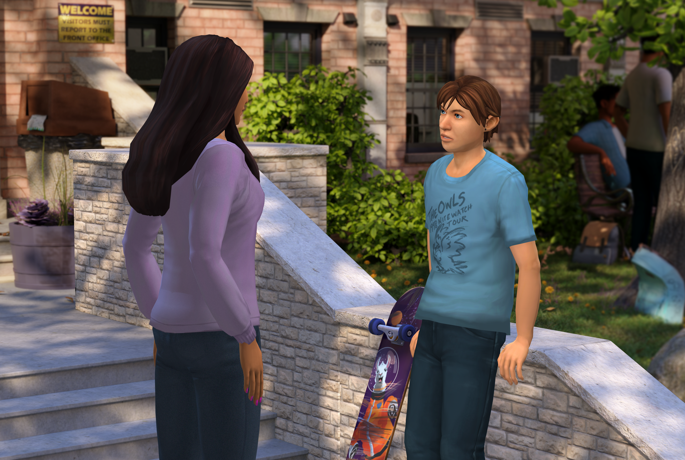




Insert Organization/
School Logo
Friend2Friend: Safe & Caring Schools
Friend2Friend: Safe & Caring Schools is an interactive simulation for middle and high school students that builds awareness, knowledge, and skills to reduce school violence through recognition of concerning behaviors and open communication between students and adults.
Important Editing Instructions:
Insert your organization’s specific Kognito URL, i.e. districtname.kognito.com
Customize the method for which your organization is asking staff to log in. Either using their school email (rostered or SSO) or self registering
Insert the name(s) of the simulation(s) you are requiring
Insert high resolution PNG or JPG of your organization’s logo in the top left corner
Learning Objectives
Identify own emotions and those of others as they relate to concerns including bullying, harassment, self-harm, and threats
Recognize when a peer's actions or statements need to be shared with adults
Investigate ways to encourage a peer in distress to open up to an adult
Recognize role in creating a safe and supportive school climate
Feel comfortable and empowered to share concerns with an adult
Understand potential resources and the roles of trusted adults
Learners interact with Virtual Humans through interactive conversations
Market
PK-12
Audience
Student
Topic
Social Emotional Learning and Violence/Bullying Prevention
Duration
19 Minutes
Access Instructions
Visit insertyourorganization.kognito.com
Select your school/institution
Create a new account using your organization email address as your username OR login using your organization email and the designated password
Launch Insert simulation name

