Slide 1

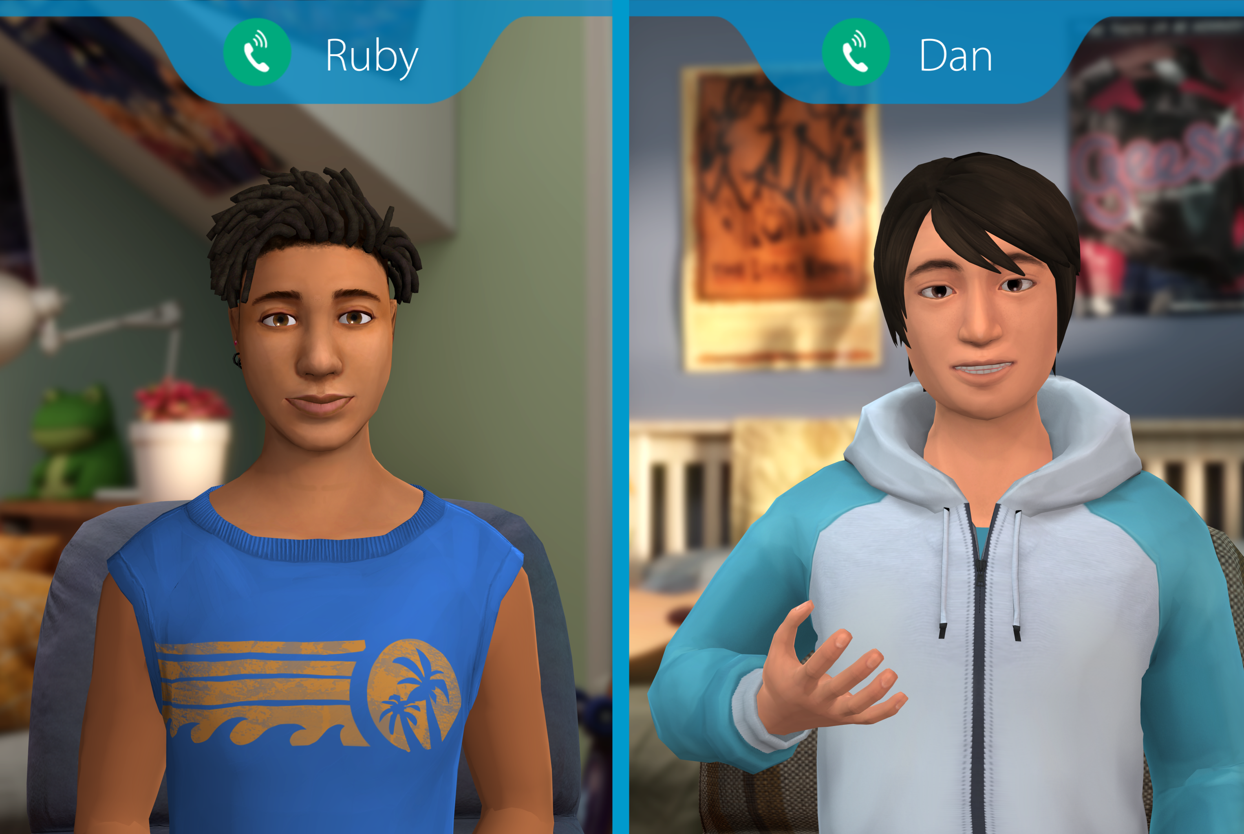




Insert Organization/
School Logo
Friend2Friend: Substance Use
Friend2Friend: Substance Use is an interactive role-play simulation for middle and high school students that builds awareness, knowledge, and skills to prevent substance misuse now and later in life by giving students the tools to better navigate real-life situations involving substances.
Important Editing Instructions:
Insert your organization’s specific Kognito URL, i.e. districtname.kognito.com
Customize the method for which your organization is asking staff to log in. Either using their school email (rostered or SSO) or self registering
Insert the name(s) of the simulation(s) you are requiring
Insert high resolution PNG or JPG of your organization’s logo in the top left corner
Learning Objectives
Understand positive social norms and refusal skills
Understand the differences between healthy and unhealthy coping strategies
Analyze risks associated with substance use
Identify substance misuse and potential support services
Understand how positive self-concept can be used to help self and others
Apply communication skills to help a friend
Create an action plan around substances based on personal values and goals
Learners interact with Virtual Humans through interactive conversations
Access Instructions
Visit insertyourorganization.kognito.com
Select your school/institution
Create a new account using your organization email address as your username OR login using your organization email and the designated password
Launch Insert simulation name
Market
PK-12
Audience
Student
Topic
Alcohol and Substance Use, Social Emotional Learning
Duration
35 Minutes

