Slide 1
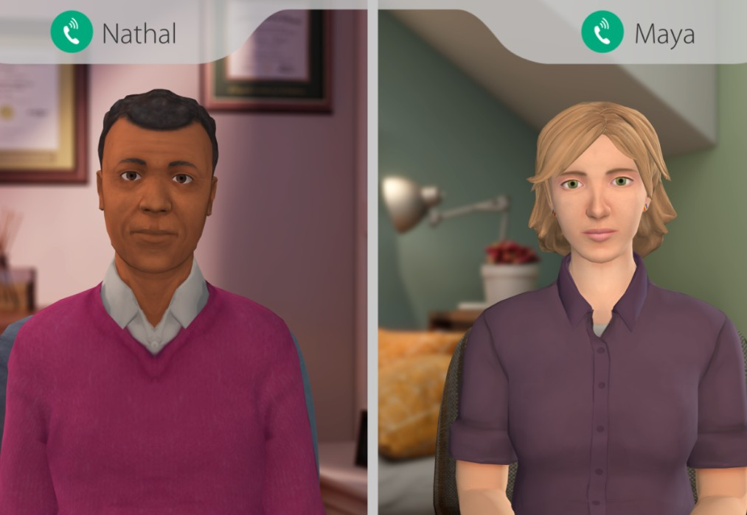
At-Risk Mental Health for Faculty & Staff
At-Risk Mental Health for Faculty & Staff is an interactive role-play simulation that builds awareness, knowledge, and skills about mental health and suicide prevention, and prepares users to lead real-life conversations with students that build resilience, strengthen relationships and connect them with support.
Learning Objectives
Increase the knowledge and awareness
Identify warning signs of psychological distress, including verbal, behavioral, and situational clues
Lead conversations with students to discuss concerns, build resilience, and increase connectedness
Assess the need for referral, motivate the student to seek help, and make a warm hand-off to support
Understand the school's specific process for student referral and counseling services
Learners interact with Virtual Humans through interactive conversations
Access Instructions
Visit ______________
Create a new account
Select ‘Employee’
Launch At-Risk Mental Health for Faculty & Staff
Audience Faculty & Staff Topic Mental Health & Well-being and Suicide Prevention Duration 20 Minutes
QR Code
Need help? Contact support@kognito.com
Available on weekdays 8am-5pm CST

