Slide 1
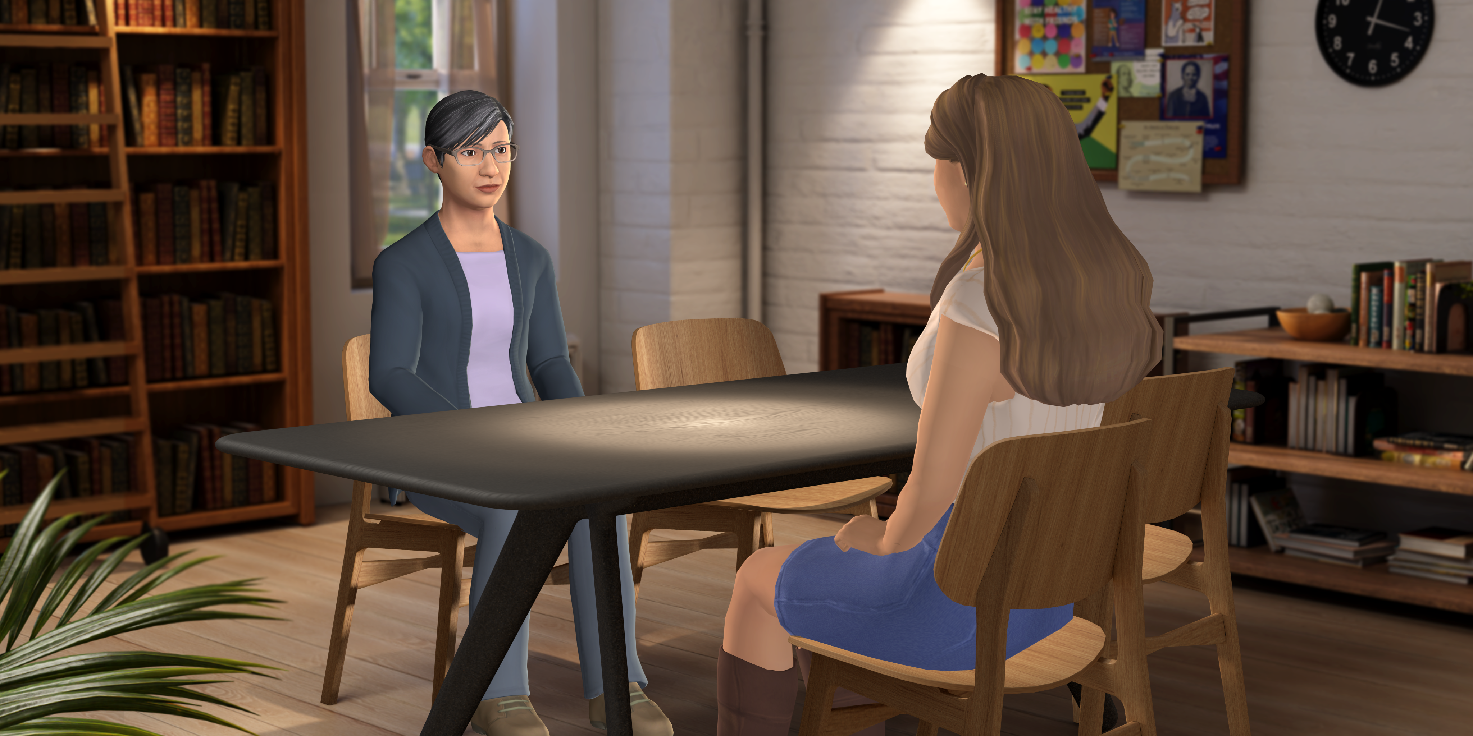
Welcome

Slide 2
Shared Expectations & Ground Rules
• Let individuals express their full thoughts and/or ideas
before responding.
• Share from your own experiences, do not assume the
experiences of others.
• It’s okay to disagree, but do so with respect, curiosity, and a
willingness to learn.
• Give everyone who wants time to speak. You may have a lot
to say, but so might someone else.
• Sharing your experiences is personal, so keep what is said
confidential.
Notes:
Graphic representation

Slide 3
Shared Expectations & Ground Rules
• It’s okay to not know the “right” thing to say.
• Be willing to hear that you may have a negative impact and
take responsibility.
• Don’t be afraid to ask questions and speak your mind.
• It’s okay to feel uncomfortable. It is in those moments we
grow through embracing a growth mindset.
Notes:
Graphic representation

Slide 4
Defining Diversity, Equity, and Inclusion
Diversity: Differences in identities such as cultures, abilities, ideas, philosophies, backgrounds, histories, personal and social identities, and lived experience.
• Share what diversity means to you. Does it mean the same thing to everyone?
Notes:
Graphic representation

Slide 5
Defining Diversity, Equity, and Inclusion
Inclusion: Supporting and embracing diversity in a way that gives everyone an unconditional sense of belonging, a feeling of physical and psychological safety, and the knowledge that they are respected and heard.
• Have you ever felt excluded? How did that make you feel?
Notes:
Graphic representation

Slide 6
Defining Diversity, Equity, and Inclusion
Equity: Working to ensure everyone gets what they need to have the access, resources, opportunities, and room to succeed.
• Can you think of a time when you or someone in your school community was treated equally (given the same resources), but should have been treated equitably (given the resources they needed to succeed)?
Notes:
Graphic representation

Slide 7
Initial Reflections
How does talking and learning about Diversity, Equity, and Inclusion make you feel? Skeptical? Curious? Defensive? Brave?
Or maybe something else entirely.
All reactions and feels are valid.
Notes:
Graphic representation

Slide 8
Growth Mindset
Now how does this particular statement make you feel?
It’s not about being right or wrong, failing or succeeding. It’s about having an open dialogue, talking about and across our differences, and strengthening our connection with others.
Notes:
Graphic representation

Slide 9
Final Reflection
What is something you want to know?
What do you want to be able to do?
Notes:
Graphic representation

Slide 10
My Identify
How do you identify? (i.e. your social identities: race, ethnicity, gender, sexual orientation, ability, etc. Not your personal identities: hobbies, interests, etc.)
Think about all the different parts of your identity.
What do you find to be the part that affects your life the greatest?
Notes:
Graphic representation

Slide 11
My Identity
When we understand our own identities and the emotions and how they make us feel, we can better empathize with others and their experiences.
Notes:
Graphic representation

Slide 12
Asking About Identify
Don’t make assumptions
Pay attention to body language
Accept their answer
Respect their wishes, their privacy, and/or how they identify
Ask questions that show: compassion, sincerity, a genuine desire to connect, and a respect for boundaries
Notes:
Graphic representation

Slide 13
Impact Vs Intent
When we think about our actions, we usually think about why we did it (impact).
But when someone else does something, we focus on how it made us feel (intent).
Notes:
Graphic representation

Slide 14
“I am sorry what I said and did was offensive.”
“I can see how that was hurtful.”
“I take responsibility for what I said and I’m working on it.”
“I’ll do better next time.”
Focus on Impact
Notes:
Graphic representation

Slide 15
Why This Matters
Take a moment to think about to think about an element of this conversation that really matters to you personally. Write a growth mindset mantra for yourself, or one that you would want to encourage others to have.
You can share one you write yourself, or use the following:
I will continue to seek out the help and advice of others when discussing
________________________________.
Notes:
Graphic representation

Slide 16
Conversation Steps
Understand Impact:
Explore the impact of their actions and better understand others’ perspectives.
Brainstorm Next Steps:
Exchange thoughts on next steps and what reconciliation might look like.
Create Space to Talk:
Help them feel like they have a place in the discussion.
Notes:
Graphic representation

Slide 17
Open-Ended Questions
Using open-ended questions encourages others to share their thoughts, perspectives, and feelings.
Be sure to ask with an open mind, without judgement or assumption
Notes:
Graphic representation

Slide 18
Reflections
Reflections are how we show we are listening and that we understand. They echo back what a person is saying.
When possible, reflect any positive values shared. When you recognize someone’s strengths and efforts. This can build their confidence and help them realize they have the power to change.
Notes:
Graphic representation

Slide 19
Ask-Tell-Ask
This is a three-step process. First, ask what they already know or ask permission to share information. This reduces defensiveness.
Then, tell a small chunk of information.
Finally, ask a follow-up question to get the person’s response. Like, “What do you make of that?”
Notes:
Graphic representation

Slide 20
I will be brave enough to admit and reflect on my biases and mistakes.
I will be strong enough to acknowledge I may not fully understand and appreciate the challenges of others.
I will be humble enough to recognize I’ll never be done learning.
I will set an example of how to approach uncomfortable topics and situations with compassion.
I will not let the fear of getting it wrong keep me from trying.
Final Affirmations
Notes:
Graphic representation

Slide 21
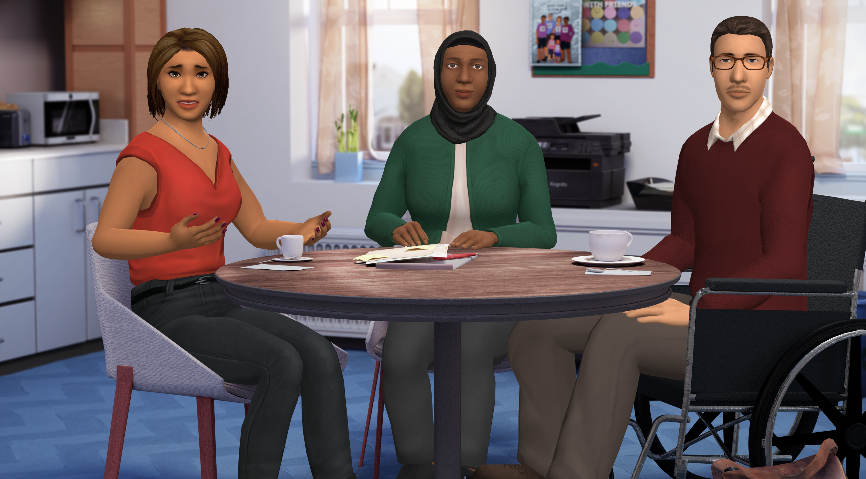
© Kognito 2021
Notes:
Graphic representation

