Slide 1

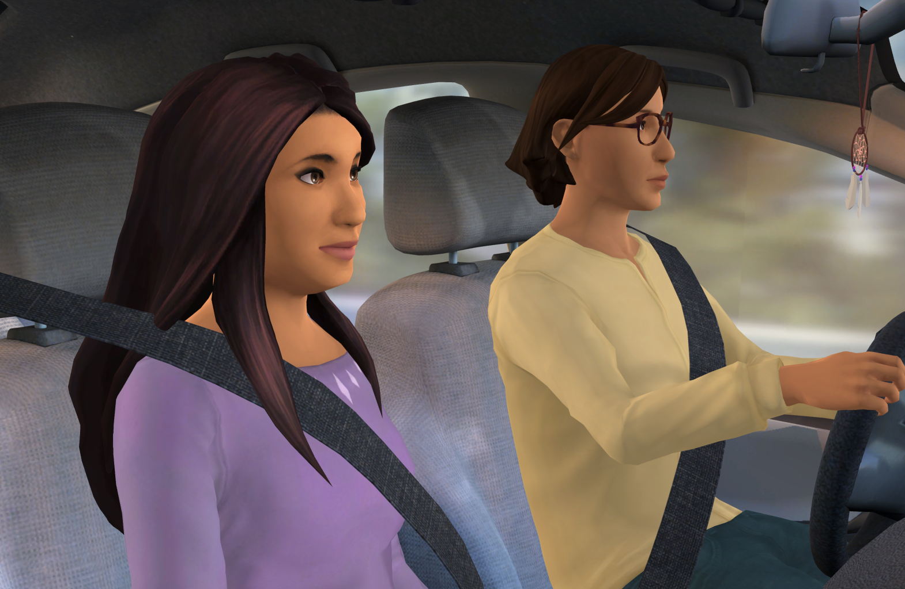





Insert Organization/
School Logo
Safe & Caring Schools for
Parents & Caregivers
Safe & Caring Schools for Parents & Caregivers is an interactive role-play simulation designed to foster a supportive school community through open communication between students and adults.
Important Editing Instructions:
Insert your organization’s specific Kognito URL, i.e. districtname.kognito.com
Customize the method for which your organization is asking staff to log in. Either using their school email (rostered or SSO) or self registering
Insert the name(s) of the simulation(s) you are requiring
Insert high resolution PNG or JPG of your organization’s logo in the top left corner
Learning Objectives
Understand the positive role you play in the lives of your children
Analyze ways to talk to an adolescent that help them to open up
Recommend appropriate actions when you hear something of concern
Identify behaviors of concern including bullying, harassment, self-harm, and threats
Access Instructions
Visit insertyourorganization.kognito.com
Select your school/institution
Create a new account using your organization email address as your username OR login using your organization email and the designated password
Launch Insert simulation name
Learners interact with Virtual Humans through interactive conversations
Market
PK-12
Audience
Caregiver and Parent/Guardian
Topic
SEL and Violence/Bullying Prevention
Duration
10 Minutes

