Slide 1

Welcome to the Protecting Our Youth Workshop
Insert your name
and contact information here

Slide 2
Protecting Our Youth
Workshop Overview
2

Slide 3
Workshop Overview
Workshop purpose
Protecting Our Youth
Take simulation
15-minute break
Discuss: Conversation techniques, role of teacher, and personal experience.
Teacher/student role plays
Takeaways

Slide 4

Group Norms
Actively participate.
Be respectful.
When sharing stories, do NOT share names or other identifying information of students or staff.
Seek help if you would like to discuss personal mental-health issues.
If you find any material triggering, take a break and rejoin later. Reach out to let me know.
Talk to me after the workshop if you are concerned about a student and have questions.

Slide 5

Self-Assessment Activity
! This is a non-graded, reflection exercise.
Rate yourself on a scale of 1 – 10, 1 being 'needs improvement' and 10 being 'excellent', for the following questions...

Slide 6
Self-Assessment Activity
Questions:
Goal Questions:
How confident do you feel connecting with your students?
How would you describe your effectiveness when checking-in with a student?
How would you describe the level of receptiveness from your students when you check in with them?
How would you describe your comfort level identifying the warning signs of abuse and neglect in your students?
How would your confidence when supporting students who are experiencing abuse or neglect?
What are some professional goals you have related to your relationship with students?
What things would you like to do differently to strengthen your relationship with students?

Slide 7
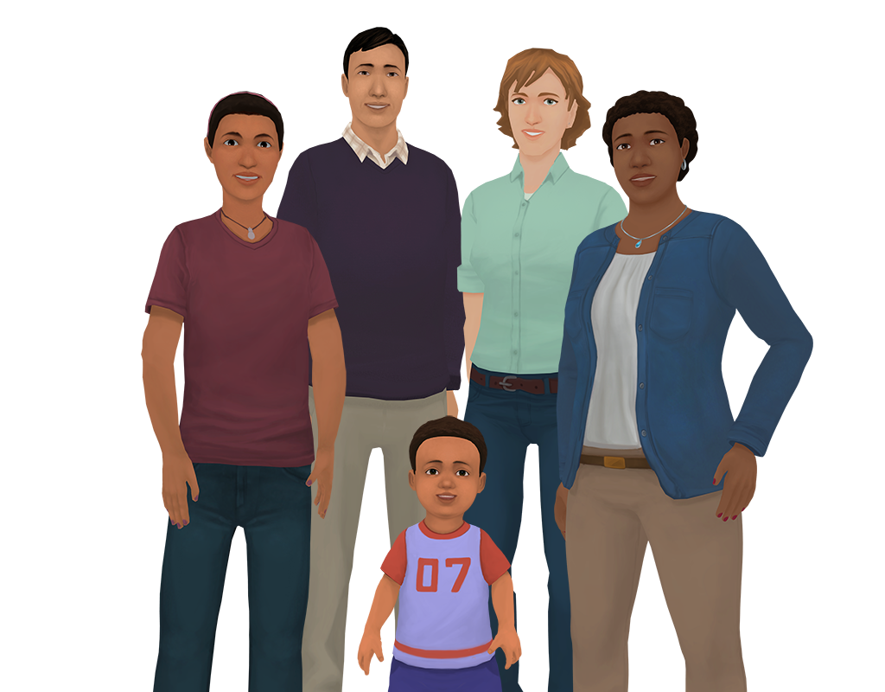







What is Kognito?
Kognito is a health simulation company that comprises learning experts, designers, technologists and implementation professionals.
Our evidence-based simulations build a variety of competencies and shape attitudes through role-play conversations with virtual people.

Slide 8


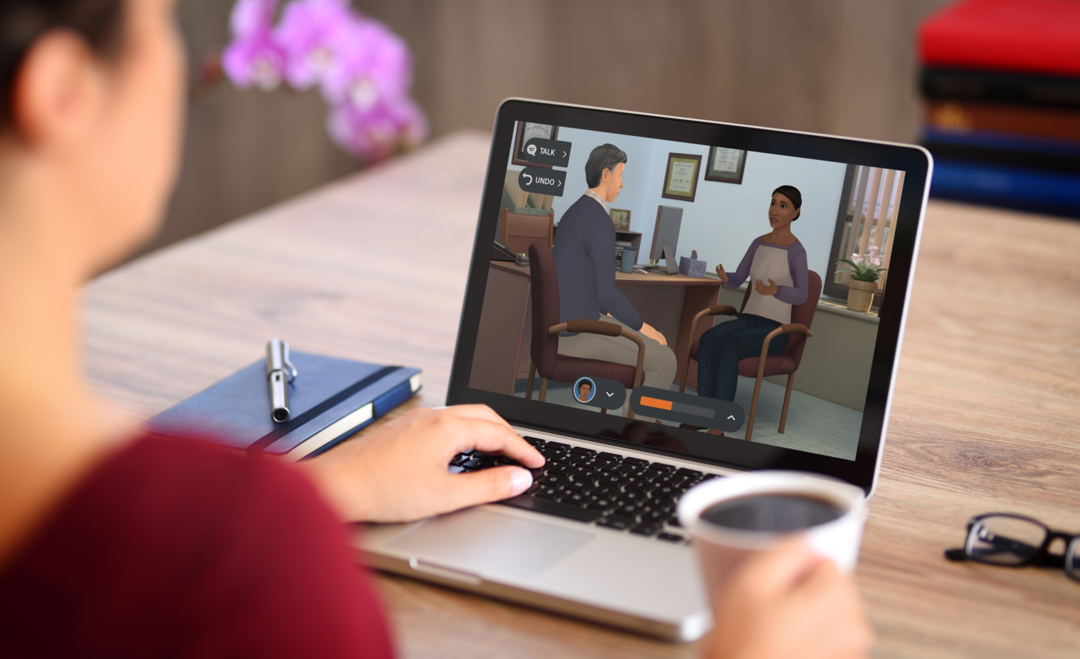
What is Kognito?
Over 1+ million educators, students, and health care professionals have used Kognito simulations to change lives, including over 500,000 K-12 educators.
Our innovative approach has resulted in partnerships with government agencies and NGOs.

Slide 9

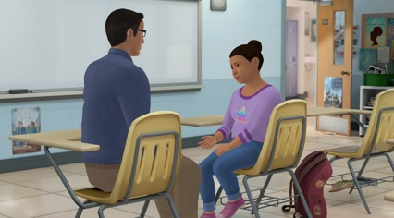

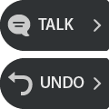






How Does A Kognito Simulation Work?
User interacts with a fully animated virtual student
Navigate through the scenarios by selecting what to say to the virtual student
Receive instant feedback from the virtual coach and engagement meter
Can undo decisions and explore
different conversation approaches
Receive personalized performance summary upon completion
Dialogue Options
Undo last selection
Coaching Feedback
Engagement Meter

Slide 10
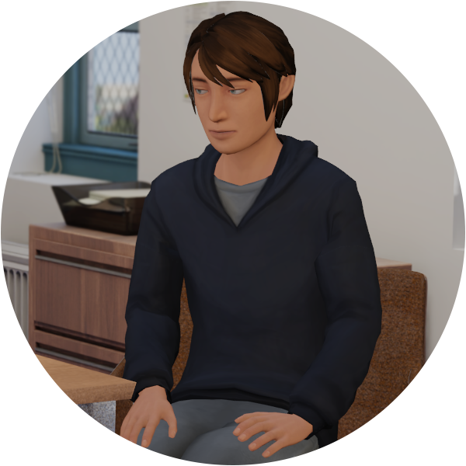
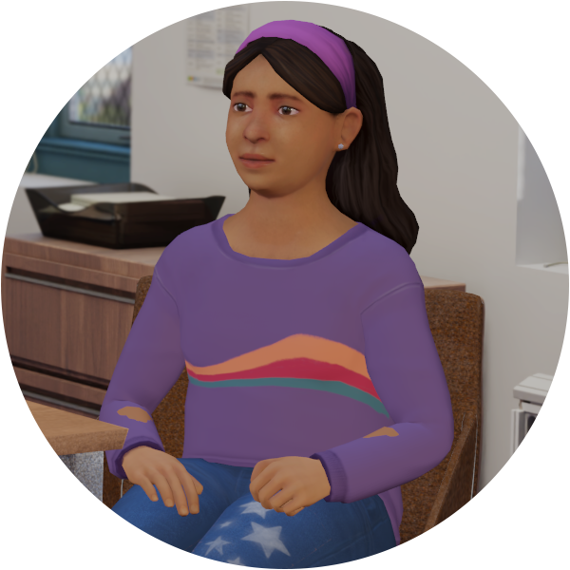

Overview of Protecting Our Youth
Practice trauma-informed conversations
Talk with Brandon, a high schooler
Talk with Marisol, an elementary schooler

Slide 11
Protecting Our Youth Learning Goal + Objectives
Learning Goal:
Learning Objectives:
Learners gain awareness, knowledge, skill, and self-confidence to identify abuse and neglect, and have trauma-informed disclosure conversation with a student.
Assess the situation to effectively have trauma-informed conversation with a child who discloses abuse, letting them know that you have listened and validating their sharing.
Examine for warning signs that assist in identifying abuse and neglect.
Examine when to report concerns and offer students potential referral options.
Identify legal responsibilities related to reporting abuse and neglect.
Define different types of child abuse and maltreatment, including physical abuse, neglect, sexual abuse, and emotional abuse.

Slide 12
Take the Simulation:
insert access information here
For technical support or any questions about your simulation, please contact Kognito at support@kognito.com or
12

Slide 13
Protecting Our Youth
Marisol
Brandon
9 years old
Having frequent stomach aches and asking to go to the nurse
Used to be very talkative, and tell funny stories to friends
Recently been more reserved, and doesn't talk to her friend group as much.
Didn't participate in Crazy Hair Day, after expressing lots of excitement leading up to
15 years old
Displaying hypervigilant behaviors
Easily startled
Wants to sit facing or near the door
Nonverbal cues include hands shaking, foot taping, wringing hands, and biting lip
Wearing long sleeves and pants despite warmer weather
Today, she asked to go to the nurse for the third time in a few weeks. The nurse sends her back quickly and checks in with you, reporting that she has no medical concerns, but is worried about Marisol's emotional well being.
Today, while doing independent work, another student came up behind him to prank him. Brandon was startled and dropped his books. After, Brandon had trouble focusing and remained distracted.

Slide 14
Protecting Our Youth
?
?
How similar did these feel to conversations you’ve had in real life?
Did you try new things in these conversations that you haven’t tried in real life?

Slide 15
Warning Signs of Child Abuse and Neglect
Not handing in assignments
Not participating in class
Changes in friend groups
Spending more time alone
Not transitioning to new activities
Being more withdrawn
Trouble regulating emotions
Not wanting to go home at the end of the day
Crying or being upset
Being absent from school
Disengaging during class time
Hood up listening to music
Skipping class
Using substances
Reckless behavior

Slide 16
Warning Signs of Child Abuse and Neglect
1.
2.
3.
4.
What kinds of things do kids your students' age struggle with emotionally?
How do young people typically cope with these kinds of struggles?
Were there any signs on the list that surprise you, or that you hadn't thought to take note of before playing through the simulation?
Why is it important for teachers to notice these things, reach out to the student, and possibly refer them for support?

Slide 17
Checking In with Students
Have you ever been concerned about a student, but you weren't sure how to ask them about what was going on?
If you have had concerns about one or more of your students in the past and have initiated conversations like this, what worked well for you?
If so, can you share what you would do differently today?
How did you decide to approach that student?
What happened?

Slide 18
Checking In with Students When You Suspect Something’s Wrong
Techniques:
Make neutral observations
Ask open-ended questions
Show empathy
Summarize what the student is saying

Slide 19
Conversation Techniques
Neutral Observable Behaviors
Reflections
Open-ended Questions
Warm Hand
Off
Ex. “It sounds like you would like to talk about something but haven't found a person who was good at listening yet.”
Ex. “What has your experience in my class been like so far?
Ex. “The counselor has helped students with similar issues. Let's walk down together. I'll introduce you.”
Ex. “I see that your reading log wasn’t updated on Monday.”

Slide 20
Neutral Observable Statements
Share what is observable to you. It's how you perceive the behavior.
Key components:
    "I" statements
    Stay grounded
    Stay focused
    Be specific
What's an example of a neutral observable statement you might use in a check-in conversation?
How do neutral observable statements help build trust and a supportive relationship with the student?

Slide 21
Open-Ended Questions
?
?
Questions that doesn't have a "yes" or "no" answer are usually better at getting at how the student might be feeling.
What's an example of an open ended question you might use in a conversation like this?
How do open ended questions help you assess a student's level of distress?

Slide 22
Reflections
Involve careful attention to what the student is saying and paraphrasing it back.
What's an example of a reflection you might use in a conversation like this?
How do reflections encourage the other person to keep opening up?
How can you use a combination of neutral observable statements, open ended questions, and reflections together in a conversation?

Slide 23

Referring Students
Referring a student is so much more than handing them off to someone else. Showing children support is what make it a warm hand-off.
Why is it important to use techniques like these, instead of just telling the student they should see the counselor?
What do you do if the student says "no"?

Slide 24
Continuing a Supportive Relationship with Students
?
?
?
How is a check in conversation about emotional and mental wellness different from other conversation you may have with your students, for example: a disciplinary conversation?
What words/tone do we often use when we're approaching a student as an authority figure?
How do these conversation techniques help us assume the role of a supportive adult, instead of approaching as an authority figure?

Slide 25
Roleplay #1
Talk with Adrian
Discussion Questions to Follow
25

Slide 26
Roleplay #2
Talk with Cleo
Discussion Questions to Follow
26

Slide 27
Local Resources
[ Insert Here ]

Slide 28

3, 2, 1 Activity
Q. What are 3 things you learned?
Q. What are 2 questions you have?
Q. What is 1 way you’re going to change your practice?

Slide 29

Bridging the Gap
Q. Where You Are: List some of your observations.
Q. Where You’d Like To Be: List some of the qualities you'd like to have when supporting children.
Q. What It Takes: List some ideas that might bridge the gap between where you are and where you’d like to be. What can you do to be one step closer to your ideal?

Slide 30
Conclusion
Faculty and staff don’t necessarily have to become well-versed in the most current psychological studies or to feel completely comfortable and knowledgeable about bullying in order to make school safer and more inclusive for students.
To make a difference, it is only necessary for them to:
Commit to keeping a respectful classroom and school environment.
Use their powers of observation and follow through by talking to their students, and colleagues, using effective conversation techniques.

Slide 31
Final Questions
?
?
How confident do you feel in your abilities to address child abuse and neglect and reach out to students, and why?
If you had to state one thing you took away from this experience, what would it be? How does it relate to your role as a faculty or staff member?

Slide 32
Thank you!
The conversations you have with students can open the door to them getting the help they need.
If you do this for just one student, you will have made a difference.

