Slide 1
Step In, Speak Up
Professional Development
Kognito. 2021. All Rights Reserved

Slide 2
Insert your name and contact information.

Slide 3
Workshop Overview
•
Workshop purpose
•
DISCUSS: Addressing biased language and harassment
Background of Step In, Speak Up
DISCUSS: Connecting with an at-risk student
Take simulation
10-minute break
Suicide
•
DISCUSS: LGBTQ student experiences
Takeaways
3

Slide 4
Group Norms
Actively participate.
Be respectful.
When sharing stories, do NOT share names or other identifying information of students or staff.
Seek help if you would like to discuss personal mental-health issues.
If you find any material triggering, take a break and rejoin later. Reach out to let me know.
•
Talk to me after the workshop if you are concerned about a student and have questions.
4

Slide 5

WRITE AN “AEIOU” DESCRIPTION.
A = Adjective - What word describes this image?
E = Emotion - How do you feel about the image?
I = Interesting - What is interesting to you about the image?
O = OMG - What surprised you about the image?
U = Um? - What question do you have about the image?

Slide 6







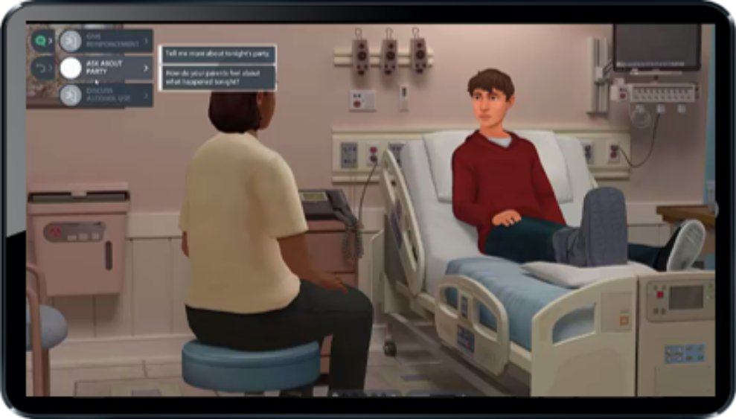
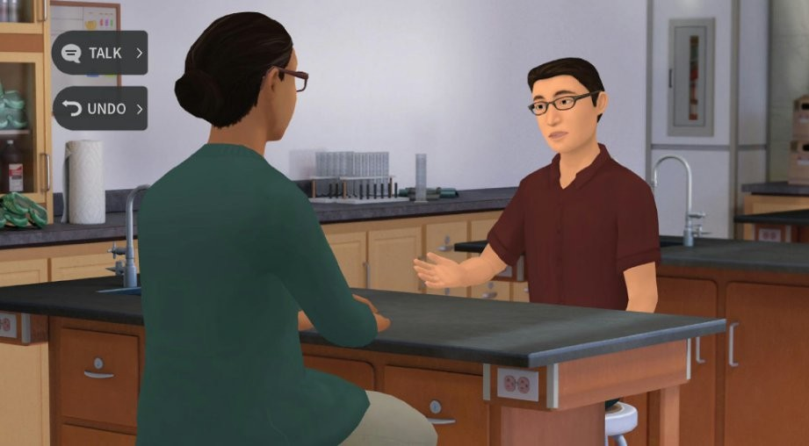
What is Kognito?
Kognito is a health simulation company that comprises learning experts, designers, technologists and implementation professionals.
Our evidence-based simulations build a variety of competencies and shape attitudes through role-play conversations with virtual people.
Over 1+ million educators, students, and health care professionals have used Kognito simulations to change lives, including over 500,000 K-12 educators.
Our innovative approach has resulted in partnerships with government agencies and NGOs.
6
6
Confidential Information. Kognito. All Rights Reserved. 2019

Slide 7


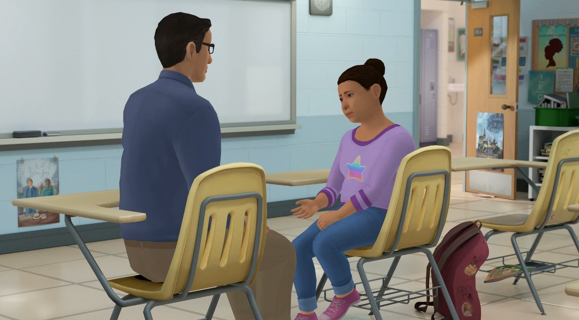









How Does A Kognito Simulation Work?
User interacts with a fully animated at-risk virtual student
Navigate through the scenarios by selecting what to say to the virtual student
Dialogue Options Undo last
selection
Receive instant feedback from the virtual coach and engagement meter
Can undo decisions and explore different conversation approaches
Receive personalized performance summary upon completion
Coaching Feedback
Engagement Meter

Slide 8
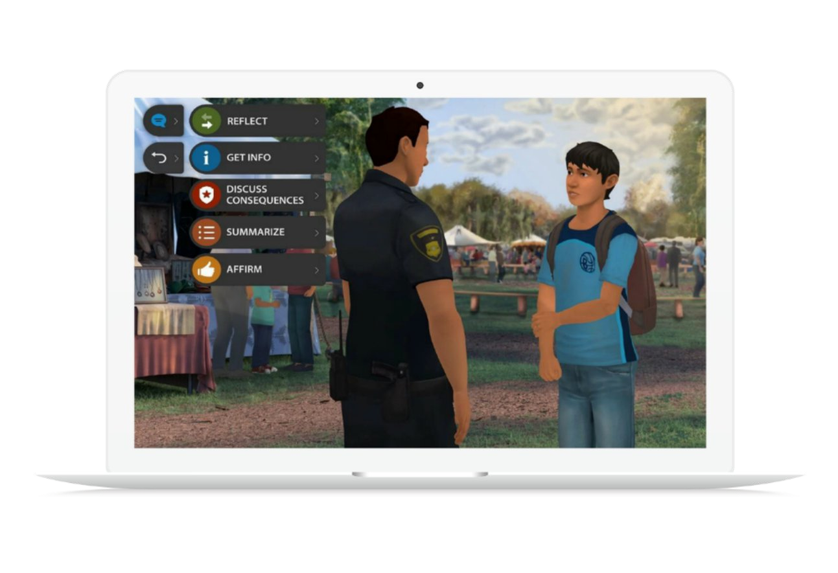
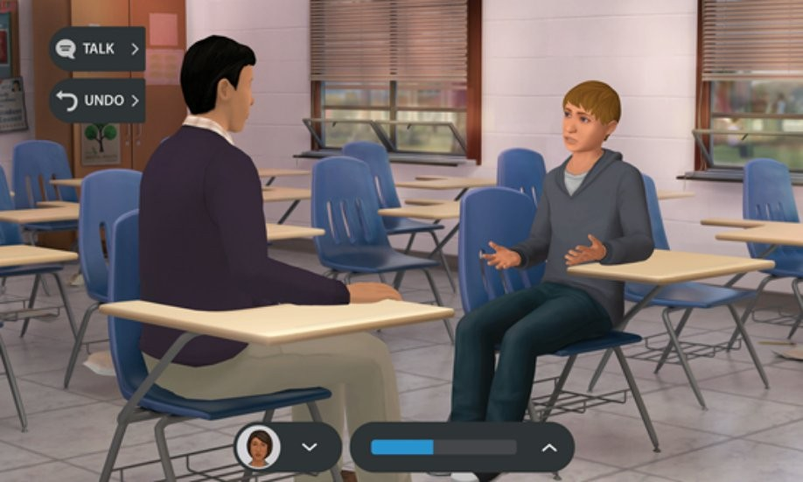
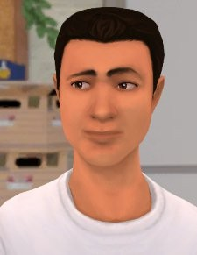
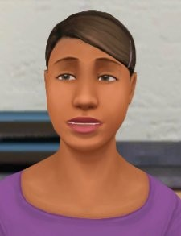
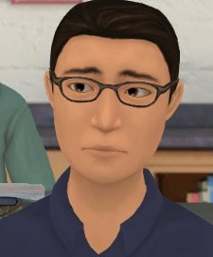
Step In, Speak Up!
TOPICS
LGBTQ Issues, bullying, classroom management, suicide
USERS
Educators, teachers, and staff
SETTINGS
High schools, youth programs, foster care, juvenile justice
DURATION
30 minutes
Biased Language: Respond when two students use an LGBTQ slur in class
Harassment: Res`pond when one student harasses another in class
Connect:
Show support for a student who’s been harassed at school
This simulation is listed in SAMHSA's National Registry of Evidence-Based Programs and Practices (NREPP).

Slide 9


At-Risk Learning Objectives
1) Recognize warning signs that a student may be suffering from psychological stress, including anxiety, depression, substance abuse and suicidal ideation
1) Initiate a conversation with a student to build resiliency and help the student identify sources of support
1) Connect the student to appropriate support services
1) Learn motivational interviewing techniques and how to avoid common pitfalls, such as attempting to diagnose the problem or giving unwarranted advice
9

Slide 10
LGBTQ Student Experiences
Students who identify as LGBTQ are much more likely to report feeling sad/helpless and to consider/attempt suicide.
Due to verbal and physical harassment and feeling isolated and unvalued by their schools, families, and communities.
Educators have the power to make schools better.
They can help LGBTQ students get better grades, lower their risks of dropping out, and save lives!
11

Slide 11
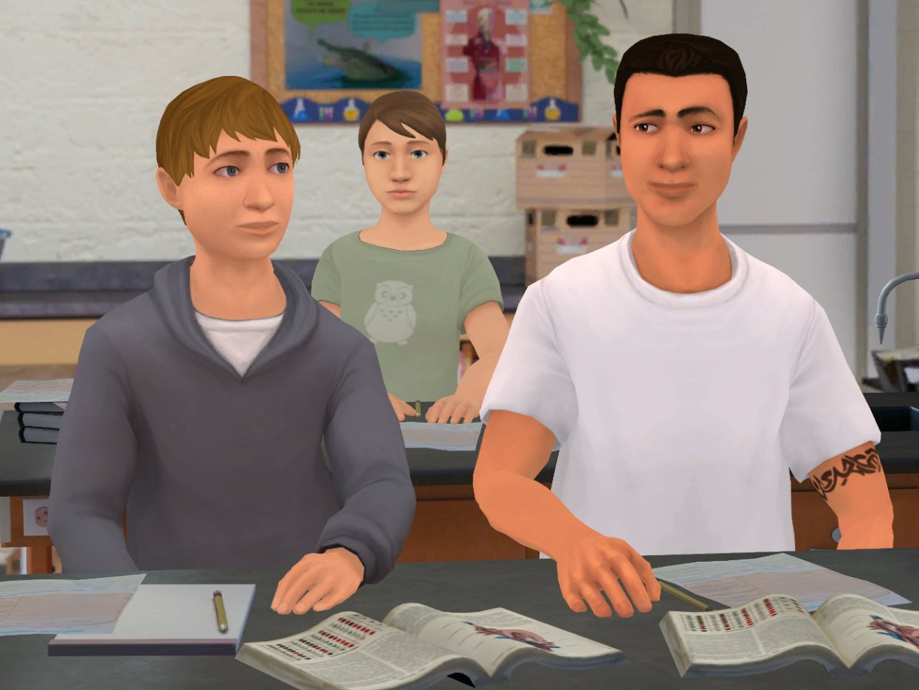
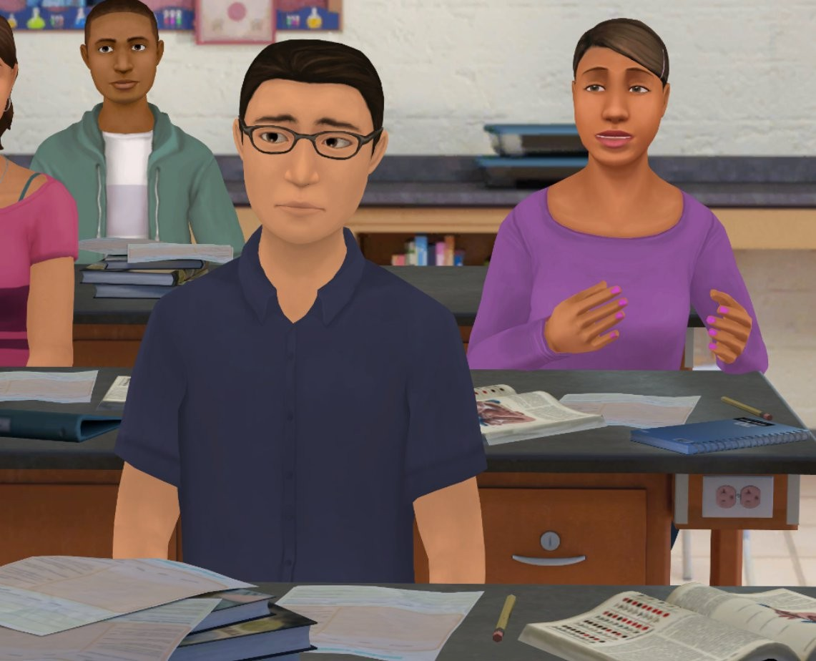
Addressing Biased Language and Harassment
12

Slide 12
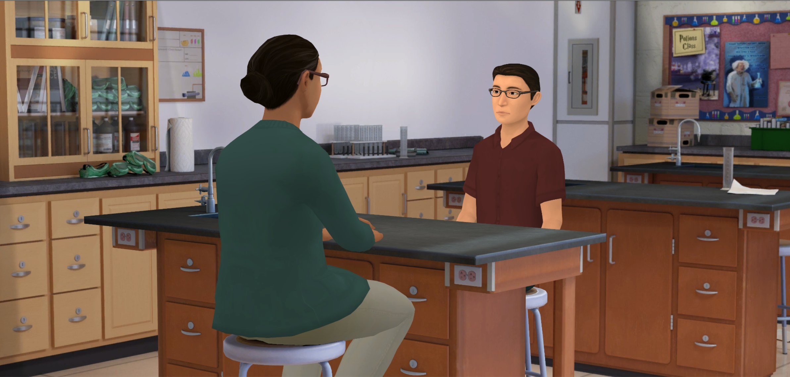
Connecting with an At-Risk Student
13

Slide 13
Suicide Warning Signs
Talking about or making plans for suicide
Expressing hopelessness about the future
Displaying severe/overwhelming emotional pain or distress
Showing worrisome behavioral or changes in behavior, such as:
  Withdrawal from or changing in social connections/situation
  Changes in sleep (increased or decreased)
  Anger or hostility that seems out of character or out of context
  Recent increased agitation or irritability
www.save.org/youthsuicide, 2017
14

Slide 14
What if a student may be suicidal?
Gather as much information as the student is willing to share:
  Are they thinking about suicide?
  Do they have a plan?
  Do they intend to act on the plan?
  Do they have the means to act on the plan?
Connect the student immediately and in person to a supportive counselor, staff member, local service provider, or crisis center.
The National Suicide Prevention Lifeline
Call or Text: 988
24 hours a day, seven days a week
15

Slide 15
How to Ask the Question
✘ You’re not thinking about suicide, are you?
✘ You wouldn’t kill yourself. I know you’re smarter than that.
✔ Are you considering suicide?
16

Slide 16
Does your school have an LGBTQ-friendly club?
What is the policy for reporting harassment?
To whom do you make a referral if you are
worried about a student?
What is the referral policy for students who may be a danger to themselves or others?
Referral Policy
17

Slide 17
Insert Local Resources

Slide 18




3, 2, 1 Activity
Q. What are 3 things you learned?
Q. What are 2 questions you have?
Q. What is 1 way you’re going to change your practice?
19

Slide 19

Bridging the Gap
Q. Where You Are: List some of your observations.
Q. Where You’d Like To Be: List some of the qualities of your ideal school.
Q. What It Takes: List some ideas that might bridge the gap between where you are and where you’d like to be. What could happen to bring your school one step closer to your ideal?
20

Slide 20


Thank you!
The conversations you have with students can open the door
to them getting the help they need.
If you do this for just one student, you will have made a difference.
21

