Slide 1

Welcome to the Dating Violence for Educators Workshop
Insert your name
and contact information here

Slide 2
Dating Violence for Educators Overview
2

Slide 3
Workshop Overview
Workshop purpose
Dating Violence Awareness
for Educators
Take simulation
15-minute break
Discuss: Conversation techniques, role of teacher, and personal experience.
Peer and teacher/student
role plays
Takeaways

Slide 4

Group Norms
Actively participate.
Be respectful.
When sharing stories, do NOT share names or other identifying information of students or staff.
Seek help if you would like to discuss personal issues.
Talk to me after the workshop if you are concerned about a student and have questions.

Slide 5

Self-Assessment Activity
! This is a non-graded, reflection exercise.
Rate yourself on a scale of 1 – 10, 1 being 'needs improvement' and 10 being 'excellent', for the following questions...

Slide 6
Self-Assessment Activity
Questions:
How confident do you feel connecting with your students?
How would you describe your comfort level responding effectively to a disclosure of dating violence?
How would you describe your confidence when supporting students who are experiencing or have experienced dating violence?
ow would you describe your comfort level approaching a student when you think there may be dating violence?

Slide 7
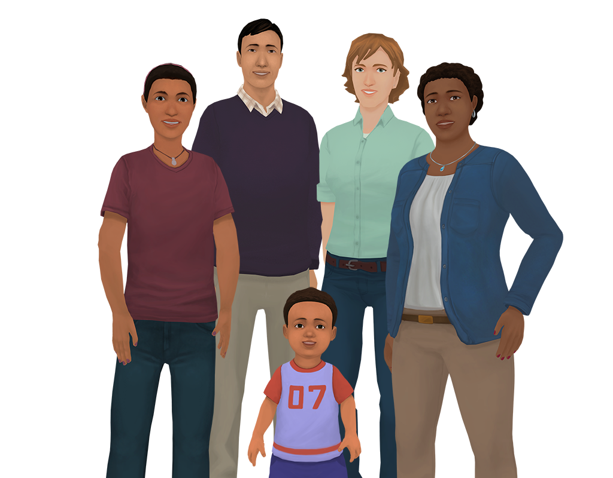







What is Kognito?
Kognito is a health simulation company that comprises learning experts, designers, technologists and implementation professionals.
Our evidence-based simulations build a variety of competencies and shape attitudes through role-play conversations with virtual people.

Slide 8



What is Kognito?
Over 1+ million educators, students, and health care professionals have used Kognito simulations to change lives, including over 500,000 K-12 educators.
Our innovative approach has resulted in partnerships with government agencies and NGOs.

Slide 9

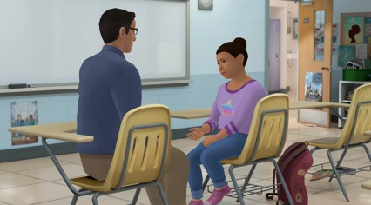

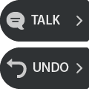






How Does A Kognito Simulation Work?
User interacts with a fully animated virtual student
Navigate through the scenarios by selecting what to say to the virtual student
Receive instant feedback from the virtual coach and engagement meter
Can undo decisions and explore
different conversation approaches
Receive personalized performance summary upon completion
Dialogue Options
Undo last selection
Coaching Feedback
Engagement Meter

Slide 10
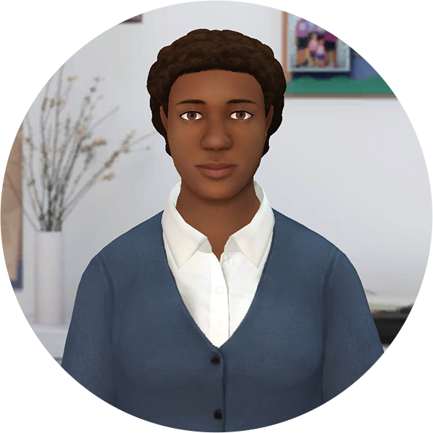
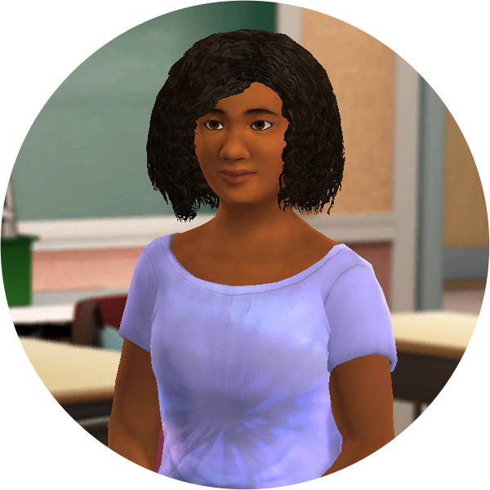

Overview of Dating Violence for Educators
Learning content examining teen dating violence
Talk with Octavia,
a peer
Talk with Jules,
a student

Slide 11
Dating Violence Awareness for Educators Learning Goal + Objectives
Learning Goal:
Learning Objectives:
Learners will gain awareness, knowledge, skill, and self-confidence to identify teen dating violence, and have a trauma-informed disclosure conversation with a student.
Identify signs of abusive relationships, including manipulation, control, verbal/mental/ emotional abuse, inappropriate physical and emotional boundaries ​
Gain or refine understanding of abusive behaviors in dating relationships​
Explore strategies and techniques for supportive conversations with students or coworkers relating to dating violence​
Practice strategies and techniques for supportive conversations with students or coworkers relating to dating violence​
Identify local and national resources for referral or reporting
Determine the difference between the characteristics of healthy versus unhealthy relationships

Slide 12
Take the Simulation:
www.KognitoCampus.com
For technical support or any questions about your simulation, please contact Kognito at support@kognito.com or 646-923-8632
12

Slide 13
Dating Violence for Educators
Octavia
Jules
A peer
She’s concerned about a student and wants to talk to you privately about it.
A student
Wants to talk to you about group assignments because she’s uncomfortable with a person in your class.

Slide 14
Dating Violence for Educators
?
?
?
How similar are these conversations to those you’ve had in real life?
Did you try novel approaches in these conversations?
Did you try novel approaches in these conversations?

Slide 15
Best practices for talking with a peer about a student who may be experiencing dating violence
Understand the warning signs your peer is noticing more specifically.
Validate their concerns.
Avoid generalizing or trivializing.
If a peer identifies a possible concern, they should always follow up.
Encourage them to give the student space to share but avoid asking overly invasive personal questions.
Remember, they don’t need to know everything to effectively refer the student.
Help them understand support options and their duty to report.
Let them know you’re there for them if they'd like to talk more.

Slide 16
Best practices for talking to a student about dating violence
Take care not to discourage these conversations.
Let the student lead the conversation.
Listen without judgement to what the student tells you and give them space to tell their own story, in their own time.
Never explicitly ask the student to discuss or reflect on their experiences with sexual misconduct.
Avoid asking questions that could imply fault.
Mirror the language used by the person sharing with you.
Avoid labeling the behavior for them.
Discuss with them what they want to do next and connect them to resources.

Slide 17
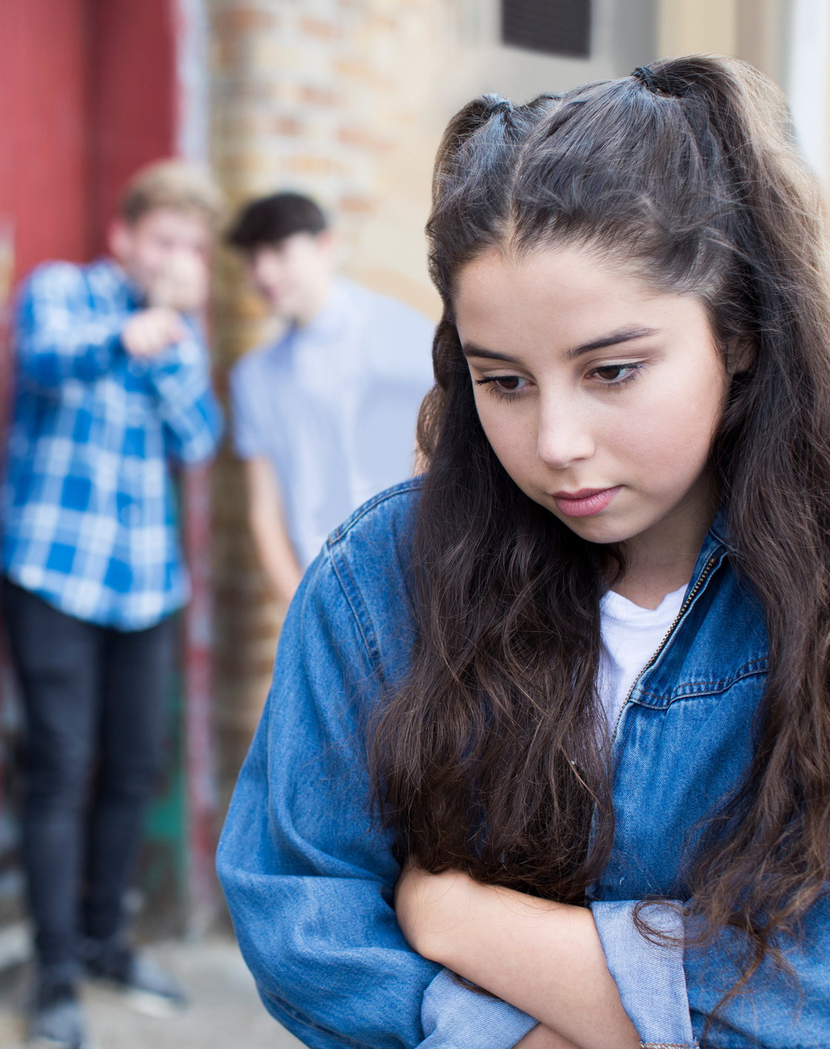
What is dating violence?
Dating violence is the use of destructive behaviors by one person to exert power and control over a dating partner. ​​
Types of abuse include emotional, digital, physical, sexual, and financial.

Slide 18

Identifying signs of distress
The first step to helping a student is noticing that they need help. By recognizing these signs, you’re able to start a conversation and connect them to resources at school and in the community that can help.
Signs of distress can be behavioral or physical.

Slide 19
Identifying signs of distress
?
?
?
What are some behavioral signs?
What are some physical signs?
Have you noticed any in your students?

Slide 20

Technique:
Identify
Talk to students about warning signs using neutral observable statements.
  Focus on impression/perception of what was observed.
  Separate the person from the behavior.
  Stay in the present and use neutral language without judgment.
How would you use a neutral observable statement to begin a conversation?

Slide 21

Technique:
Approach
Talk to the student using empathetic listening.
Show them you believe them and you’re there to support them.
How could you show that you’re listening?

Slide 22

Technique:
Refer
Follow the relevant policies for your school.
There is no pressure to do more than the steps outlined in those policies. If you'd like, and the student consents, you can share additional support resources, but it is not required.
In a conversation with a student who discloses intimate partner violence, when should you mention support options?
How do you refer the student supportively?

Slide 23
Healthy vs. Unhealthy Relationships
?
?
?
What are the signs of a healthy relationship?
What are the signs of an unhealthy relationship?
What signs have you noticed in your students?

Slide 24
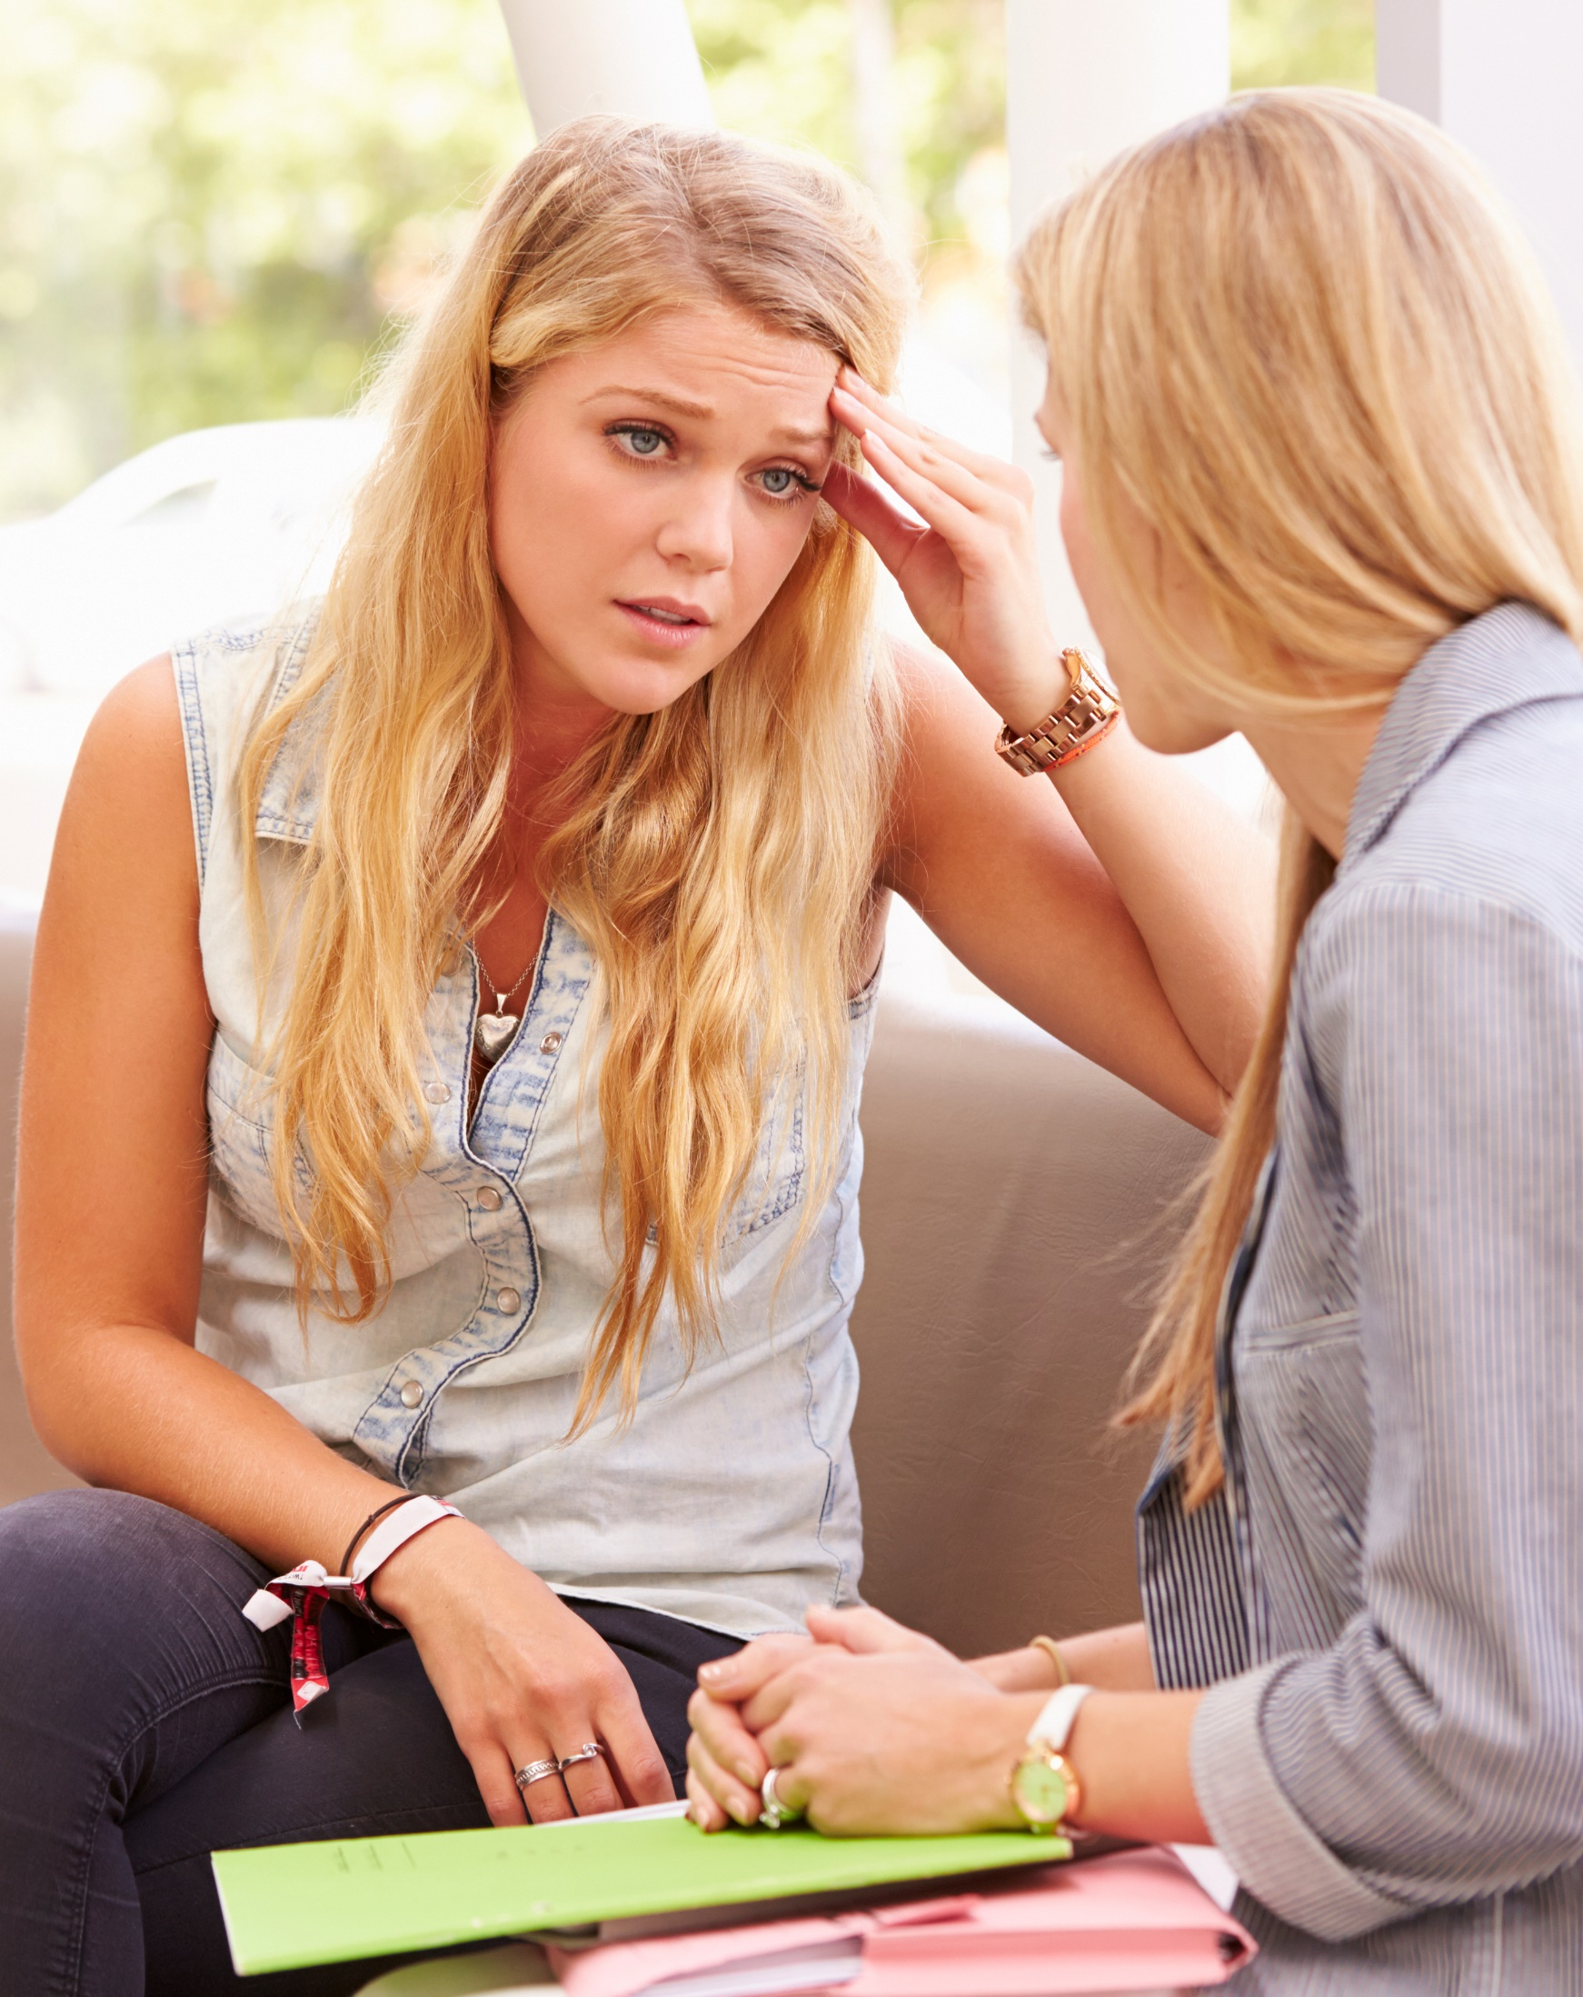
Checking in with students
What are some different ways of conducting check-in conversations that you’ve tried with your students? Have any of them worked better than others?​
What do you struggle with when you’re checking in with students?​
​What has worked well?

Slide 25

Acknowledging the disclosure
It’s important to let your student know you hear them. Talk to them using empathetic listening and make sure you show support.
What are some ways in which you could affirm a student sharing their experience with you?
How have you let your students know you’re available for them?

Slide 26
Resources for referring students
Ask permission to share information about possible resources. It is the student’s choice what options they choose to pursue, if any. Even if they choose not to use a resource right away, they may decide to use them later. ​It is never the wrong time to offer potential referral points.
How familiar are you with your school’s resources? What questions do you have?
School-based resources
Guidance.​
Trusted adult at school.​
Community-based resources​
Local domestic violence program.​
Counselor.​
Social worker.​
State coalition on dating violence.​
Hotlines (National Teen Dating Hotline, National Domestic Violence Hotline, National Sexual Assault Hotline).

Slide 27
Reporting dating violence
You have a duty to report incidents of dating violence to the appropriate designee. View the resource section for your school’s policies. There also may be district-and building-specific protocols.
If possible, before a student discloses information about dating violence, inform them that you have a duty to report dating violence that they tell you about. If it's not possible before, inform them as soon as possible after.
What could you say to inform a student about your duty to report? Before a disclosure? After?

Slide 28
Roleplay Scenario A
Talk with Kay
Discussion Questions to Follow
28

Slide 29
Roleplay Scenario A
Talk with Kay
Kay
You have noticed some signs of distress in one of your students, Alex. They have been getting into arguments with classmates, and overall seem easily angered. You reach out to one of your peers to talk about how to support Alex.
Peer
Your coworker Kay is concerned about a student in their class who may be experiencing dating violence. They Kay approaches you to talk about how to support the student.

Slide 30
Roleplay Scenario B
Talk with Robin
Discussion Questions to Follow
30

Slide 31
Roleplay Scenario B
Tak with Robin
Concerned Teacher
Your student, Robin, who used to be the first person in the classroom, has been arriving late to class recently, often seeming tired. You want to approach Robin about the signs you have noticed and offer support.
Robin
Your partner insists you spend all your time together and becomes jealous when you do not. You've been getting little sleep, answering the phone at all hours to avoid your partner’s accusations of cheating if you don't answer your calls right away.

Slide 32
Local Resources
[ Insert Here ]

Slide 33

3, 2, 1 Activity
Q. What are 3 things you learned?
Q. What are 2 questions you have?
Q. What is 1 way you’re going to change your practice?

Slide 34

Bridging the Gap
Q. Where You Are: List some of your observations.
Q. Where You’d Like To Be: List some of the qualities you'd like to have when supporting children.
Q. What It Takes: List some ideas that might bridge the gap between where you are and where you’d like to be. What can you do to be one step closer to your ideal?

Slide 35

Conclusion
Educators and staff don’t necessarily have to become well-versed in the most current psychological studies to support their students.
It’s important to have supportive conversations to offer the best opportunities for students to share in a space that reduces barriers from fear of embarrassment, judgment, or repercussions.

Slide 36
Final Questions
?
?
How confident do you feel in your abilities to support your students in a conversation about possible dating violence?
If you had to state one thing you took away from this experience, what would it be? How does it relate to your role as an educator?

Slide 37

Congratulations and Thank You!
If a student reveals to you that they are in an abusive relationship, congratulations…
You are considered a “safe space.”
You are trusted.
If you notice red flags and have concerns, congratulations …
You have a unique opportunity to make a difference in a student’s life and help them to be safe.

Slide 38

Stay Connected
We invite you to be part of the Kognito community online and connect with us on social media. Share your experience using Kognito, hear from experts, stay in the know about new products and be the first to hear about conferences and online events.
LinkedIn www.linkedin.com/company/kognito/
Facebook www.facebook.com/KognitoConversations
YouTube www.youtube.com/@kognito3071
Twitter twitter.com/Kognito
You can browse our complete library of PK-12 solutions at https://kognito.com/pk-12/.
For support, please visit support.kognito.com or email us at support@kognito.com.

