Slide 1

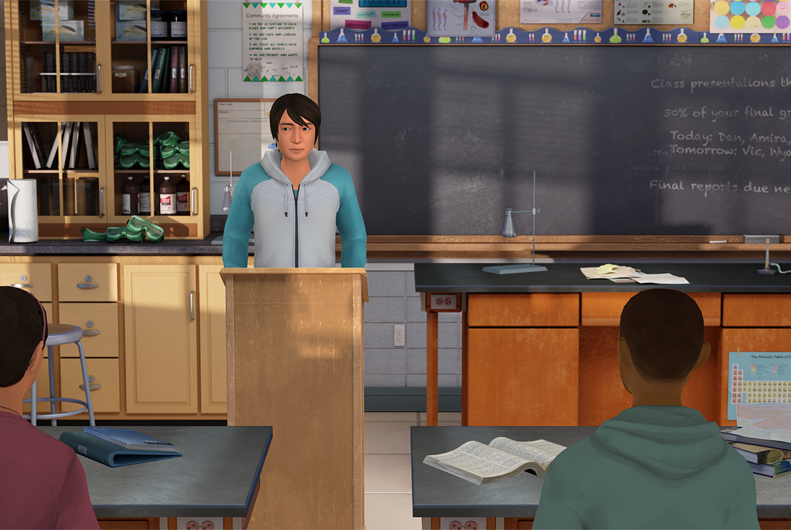

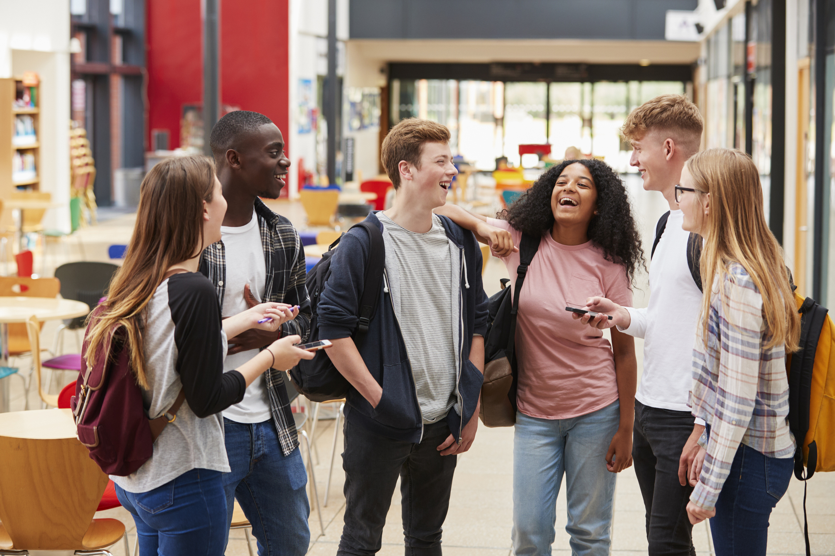



Insert Organization/
School Logo
Friend2Friend: Resiliency & Growth
Friend2Friend: Resiliency & Growth is an interactive role-play simulation that equips students with the knowledge and skills to identify and help each other navigate responses to academic as well as everyday challenges and setbacks in a positive way.
Important Editing Instructions:
Insert your organization’s specific Kognito URL, i.e. districtname.kognito.com
Customize the method for which your organization is asking staff to log in. Either using their school email (rostered or SSO) or self registering
Insert the name(s) of the simulation(s) you are requiring
Insert high resolution PNG or JPG of your organization’s logo in the top left corner
Learning Objectives
Name and manage the emotions from challenges and failures
Recognize emotions and unhelpful thoughts and use self-talk to reframe them
Learn and grow from experiences, including failure
Analyze mistakes to see what can be learned
Plan for skills, values, and resources that can help in the future
Access Instructions
Visit insertyourorganization.kognito.com
Select your school/institution
Create a new account using your organization email address as your username OR login using your organization email and the designated password
Launch Insert simulation name
Learners interact with Virtual Humans through interactive conversations
Market
PK-12
Audience
Student
Topic
Resiliency & Growth
Duration
30 Minutes

