Slide 1

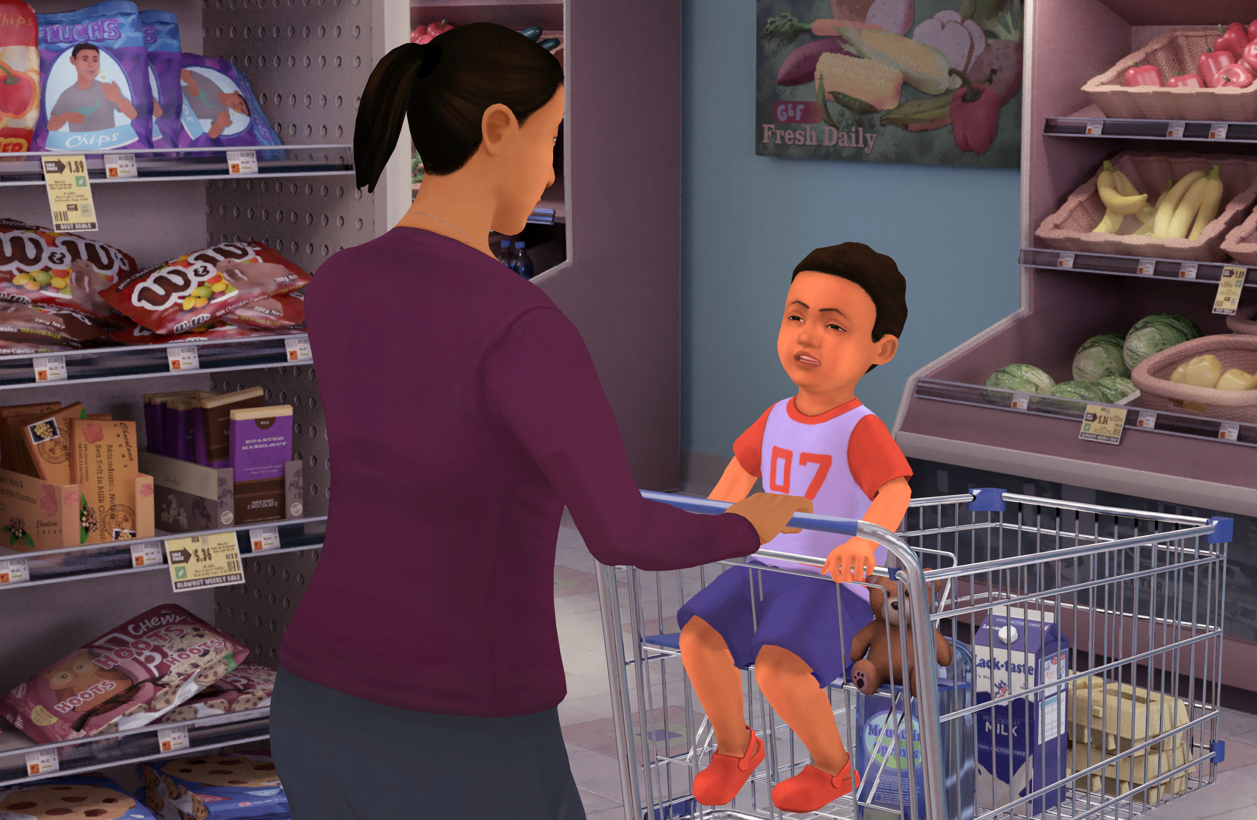




Insert Organization/
School Logo
Calm Parents, Healthy Kids
Calm Parents, Healthy Kids is an interactive role-play simulation that builds the skills of parents to be responsive to their 2- to 5-year-old child in a calm and loving way during a series of stressful everyday situations, such as a tantrum in the supermarket or a fight with another child on the playground.
Important Editing Instructions:
Insert your organization’s specific Kognito URL, i.e. districtname.kognito.com
Customize the method for which your organization is asking staff to log in. Either using their school email (rostered or SSO) or self registering
Insert the name(s) of the simulation(s) you are requiring
Insert high resolution PNG or JPG of your organization’s logo in the top left corner
Learning Objectives
Learn to prepare for situations that are likely to involve parent-child conflict
Learn to acknowledge your emotions toward the child to respond appropriately
Learn to limit consequences to those that focus on the child's behavior and their sense of safety or self-esteem
Learn to de-escalate situations and draw attention to the desired behavior instead of the undesired
Access Instructions
Visit insertyourorganization.kognito.com
Select your school/institution
Create a new account using your organization email address as your username OR login using your organization email and the designated password
Launch Insert simulation name
Learners interact with Virtual Humans through interactive conversations
Market
PK-12
Audience
Caregiver and Parent/Guardian
Topic
Communication Skills
Duration
30 Minutes

